Slide 1

2 Days AI&ML Workshop
Rushikesh S. Tanksale

Slide 2
Day 1
Introduction to AI
History
Types
ML & Evolution
DL & Its Application
NLP & Its Application
Fundamentals of ML
Supervised, Unsupervised & Semi- Supervised Learning
Basics Terminology: Features, Labels, Training, Testing, Etc.
Setting up Environment in Google Colab

Slide 3
Day 1
Python Basics
Introduction to Data Loading & Data Cleaning
CSV, JSON, XLSX.
Handling Missing Values
Data Normalization
Generating Data Statistics
Importance of EDA (Exploratory Data Analysis)
Matplotlib
Seaborn
Generating Basics Visualizations

Slide 4
Day 1
Practical Exercise with EDA & Python
Loading & Exploring Dataset
Identifying Patterns & Outliers & Trends
Introduction to Scikit-Learn
Model Tuning
Accuracy, Precision, Recall, F1-Score
Overfitting, Underfitting
Supervised Learning Algorithms
Regression: Linear
Classification: KNN, SVM, Logistics, NB

Slide 5
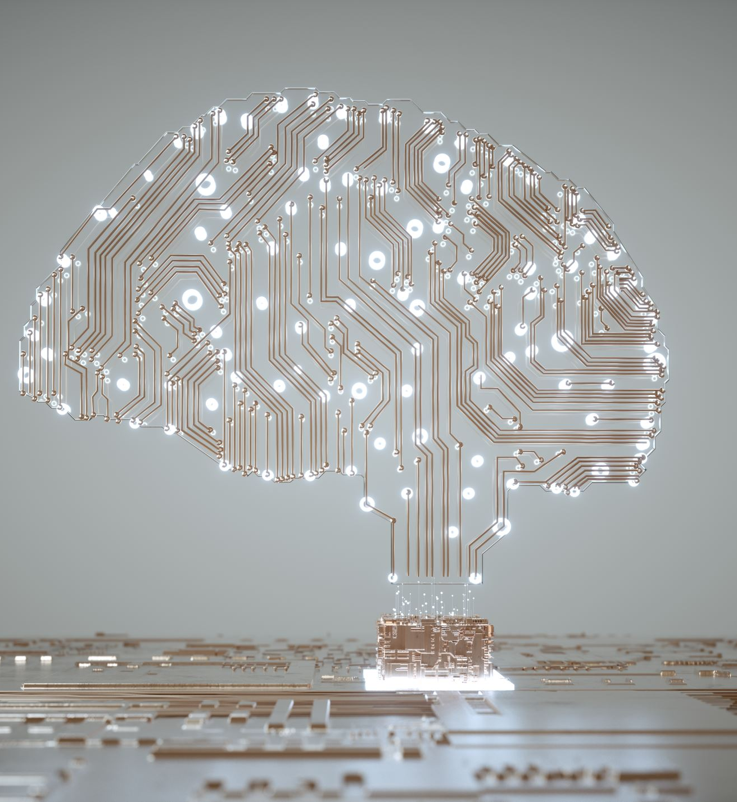
Artificial Intelligence
By Rushikesh S. Tanksale

Slide 6
Contents - I
Introduction to AI
Working of AI
Advantages & Disadvantages
Strong vs Weak AI
Example & Usage
Augmented Intelligence vs Artificial Intelligence
History of AI
AI as a Service
AI VS ML VS DL
Example

Slide 7
Content - II
Introduction to NLP
How it Works
Why it is important
Techniques and Methods of NLP
Use Cases
Benefits & Challenges
History & Evolution
Natural Language Understanding
NLU vs NLP vs NLG
Example

Slide 8
Introduction to ai
What is AI?
How Does AI Work?
Learning Processes
Reasoning Processes
Self-Correction Processes
Why is AI Important?
Notes:
Artificial intelligence is the simulation of human intelligence processes by machines, especially computer systems. Specific applications of AI include expert systems, natural language processing, speech recognition and machine vision.
As the hype around AI has accelerated, vendors have been scrambling to promote how their products and services use AI. Often what they refer to as AI is simply one component of AI, such as machine learning. AI requires a foundation of specialized hardware and software for writing and training machine learning algorithms. No one programming language is synonymous with AI, but a few, including Python, R and Java, are popular. In general, AI systems work by ingesting large amounts of labeled training data, analyzing the data for correlations and patterns, and using these patterns to make predictions about future states. In this way, a chatbot that is fed examples of text chats can learn to produce lifelike exchanges with people, or an image recognition tool can learn to identify and describe objects in images by reviewing millions of examples.
Learning processes. This aspect of AI programming focuses on acquiring data and creating rules for how to turn the data into actionable information. The rules, which are called algorithms, provide computing devices with step-by-step instructions for how to complete a specific task.
Reasoning processes. This aspect of AI programming focuses on choosing the right algorithm to reach a desired outcome.
Self-correction processes. This aspect of AI programming is designed to continually fine-tune algorithms and ensure they provide the most accurate results possible.
AI is important because it can give enterprises insights into their operations that they may not have been aware of previously and because, in some cases, AI can perform tasks better than humans. Particularly when it comes to repetitive, detail-oriented tasks like analyzing large numbers of legal documents to ensure relevant fields are filled in properly, AI tools often complete jobs quickly and with relatively few errors.
This has helped fuel an explosion in efficiency and opened the door to entirely new business opportunities for some larger enterprises. Prior to the current wave of AI, it would have been hard to imagine using computer software to connect riders to taxis, but today Uber has become one of the largest companies in the world by doing just that. It utilizes sophisticated machine learning algorithms to predict when people are likely to need rides in certain areas, which helps proactively get drivers on the road before they're needed. As another example, Google has become one of the largest players for a range of online services by using machine learning to understand how people use their services and then improving them. In 2017, the company's CEO, Sundar Pichai, pronounced that Google would operate as an "AI first" company.
Today's largest and most successful enterprises have used AI to improve their operations and gain advantage on their competitors.
Advantages
Good at detail-oriented jobs;
Reduced time for data-heavy tasks;
Delivers consistent results; and
AI-powered virtual agents are always available.
Disadvantages
Expensive;
Requires deep technical expertise;
Limited supply of qualified workers to build AI tools;
Only knows what it's been shown; and
Lack of ability to generalize from one task to another.

Slide 9
weak ai
Definition
Examples
Purpose
Awareness
Data Processing
Notes:
The artificial intelligence that we now see in our daily lives is what we refer to as weak (narrow AI). It’s actually the only artificial intelligence that exists today. It’s called weak because it has limited functionality. The AI algorithms are built to accomplish specific tasks rather than possess full cognitive abilities like the human brain. Weak AI illustrates that intelligent behavior can be modeled. Examples of weak AI include Siri, Alexa and Google search.
Weak AI is in action when there can be a programmed response such as when AI runs a chess program. These algorithms will process data to find things they know and then classify based on training/programming. They can’t veer off the programmed path.
Weak AI has changed many aspects of business and our personal lifestyles by being able to solve or complete tasks much quicker or better than humans can. It’s what powers chatbots and recommendation engines on streaming services. Weak AI can also discover patterns in volumes of data to help diagnose disease and develop treatments. It’s certainly been a transformative technology thus far.
Weak AI models intelligent human behavior, which allows machines to solve complex problems.
Narrow AI is programmed to operate within a set of pre-defined functions that the programming is taught to complete or solve.
Weak AI does not achieve self-awareness.
Narrow AI classifies data.

Slide 10
Strong ai
Definition
Examples
Purpose
Awareness
Data Processing
Notes:
Strong or general artificial intelligence at this point is only theoretical. It’s when machines develop consciousness and decision-making on par (or better) than humans. When strong AI is achieved, the machines won’t rely on human programming to be able to think or accomplish tasks. This is the AI imagined in sci-fi stories such as “I-Robot” and “The Terminator.”
Additionally, machines with strong AI will be able to exhibit self-awareness and emotions. Ultimately, the goal with general AI is a machine that has intelligence in true human form.
General AI is currently hypothetical, but when or if it’s realized, machines would have full human cognitive abilities.
Strong AI will have a mind of its own to be able to accomplish any type of task its “mind” can envision.
Strong AI will be advanced enough to be considered truly intelligent and fully self-aware.
General AI uses clustering and association.

Slide 11
Four types of ai
Reactive Machines
Limited Memory
Theory of Mind
Self-Awareness
Notes:
Arend Hintze, an assistant professor of integrative biology and computer science and engineering at Michigan State University, explained in a 2016 article that AI can be categorized into four types, beginning with the task-specific intelligent systems in wide use today and progressing to sentient systems, which do not yet exist. The categories are as follows:
Type 1: Reactive machines. These AI systems have no memory and are task specific. An example is Deep Blue, the IBM chess program that beat Garry Kasparov in the 1990s. Deep Blue can identify pieces on the chessboard and make predictions, but because it has no memory, it cannot use past experiences to inform future ones.
Type 2: Limited memory. These AI systems have memory, so they can use past experiences to inform future decisions. Some of the decision-making functions in self-driving cars are designed this way.
Type 3: Theory of mind. Theory of mind is a psychology term. When applied to AI, it means that the system would have the social intelligence to understand emotions. This type of AI will be able to infer human intentions and predict behavior, a necessary skill for AI systems to become integral members of human teams.
Type 4: Self-awareness. In this category, AI systems have a sense of self, which gives them consciousness. Machines with self-awareness understand their own current state. This type of AI does not yet exist.

Slide 12
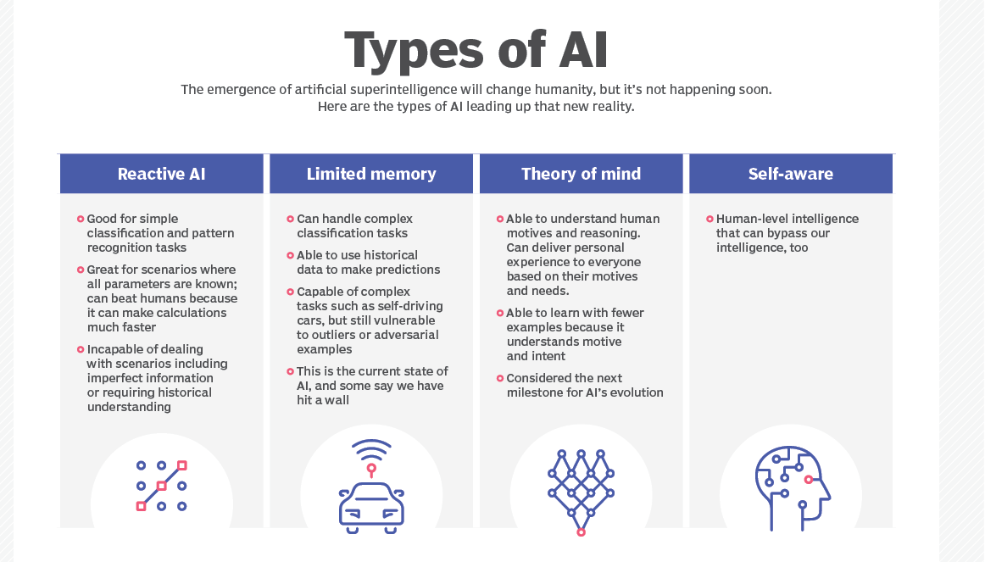

Slide 13
Example & Usage today
Automation
Machine Vision
Natural Language Processing
Robotics
Self Driving Cars
Machine Learning
Supervised
Unsupervised
Reinforcement
Notes:
Automation. When paired with AI technologies, automation tools can expand the volume and types of tasks performed. An example is robotic process automation (RPA), a type of software that automates repetitive, rules-based data processing tasks traditionally done by humans. When combined with machine learning and emerging AI tools, RPA can automate bigger portions of enterprise jobs, enabling RPA's tactical bots to pass along intelligence from AI and respond to process changes.
Machine learning. This is the science of getting a computer to act without programming. Deep learning is a subset of machine learning that, in very simple terms, can be thought of as the automation of predictive analytics. There are three types of machine learning algorithms:
Supervised learning. Data sets are labeled so that patterns can be detected and used to label new data sets.
Unsupervised learning. Data sets aren't labeled and are sorted according to similarities or differences.
Reinforcement learning. Data sets aren't labeled but, after performing an action or several actions, the AI system is given feedback.
Machine vision. This technology gives a machine the ability to see. Machine vision captures and analyzes visual information using a camera, analog-to-digital conversion and digital signal processing. It is often compared to human eyesight, but machine vision isn't bound by biology and can be programmed to see through walls, for example. It is used in a range of applications from signature identification to medical image analysis. Computer vision, which is focused on machine-based image processing, is often conflated with machine vision.
Natural language processing (NLP). This is the processing of human language by a computer program. One of the older and best-known examples of NLP is spam detection, which looks at the subject line and text of an email and decides if it's junk. Current approaches to NLP are based on machine learning. NLP tasks include text translation, sentiment analysis and speech recognition.
Robotics. This field of engineering focuses on the design and manufacturing of robots. Robots are often used to perform tasks that are difficult for humans to perform or perform consistently. For example, robots are used in assembly lines for car production or by NASA to move large objects in space. Researchers are also using machine learning to build robots that can interact in social settings.
Self-driving cars. Autonomous vehicles use a combination of computer vision, image recognition and deep learning to build automated skill at piloting a vehicle while staying in a given lane and avoiding unexpected obstructions, such as pedestrians.

Slide 14
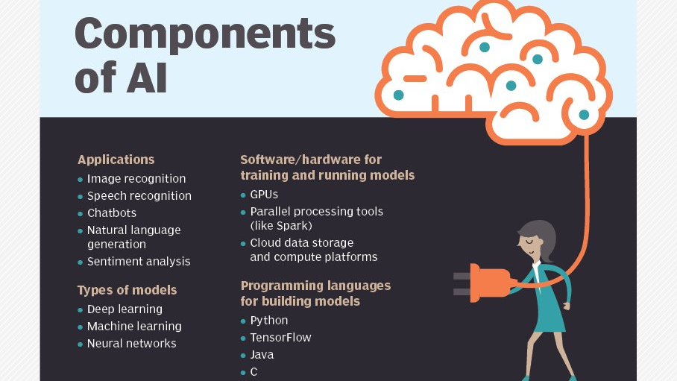

Slide 15
Applications
AI in Healthcare
AI in Business
AI in Education
AI in Finance
AI in Law
AI in Manufacturing
AI in Banking
AI in Transportation
Security

Slide 16
Augmented intelligence vs artificial intelligence
What is Augmented Intelligence
How it Works
How it is used
The difference
Notes:
Augmented intelligence is designed to work with humans to enhance their capabilities, rather than remove humans from the picture. It relies on machine learning and deep learning to crunch through reams of data, which humans then use to make decisions and take action.
Augmented intelligence is a subset of artificial intelligence in which AI technologies assist humans rather than replace them. It’s typically done using machine learning to analyze data and help humans make smarter decisions.
Augmented intelligence uses AI and machine learning to gather structured and unstructured data from multiple sources, which it then analyzes and interprets.
When teamed with humans, augmented intelligence systems have the benefit “of a bigger picture on common sense,” which AI systems tend to lack due to their deep and narrow view of data and information, Kambhampatihe said. For example, two supercomputers programmed to play chess may attempt to finish the game despite a fire in their office, whereas a supercomputer playing chess against a human would be instructed by the human to turn itself off.
SELF-DRIVING CARS NAVIGATING SAFELY
“Self-driving cars” might sound like no human oversight is needed, but that isn’t always the case. In fact, Tesla vehicles use augmented intelligence. Although its autopilot software is being developed so that cars can largely navigate roads autonomously, there are times when they require human intervention in certain emergencies, like cars suddenly pulling into the driver’s lane or slamming on the brakes on short notice.
HELPING RETAILERS IDENTIFY STORE BOTTLENECKS
Retail is one industry that has a lot to gain from augmented intelligence. The technology can be used to analyze customer and storefront data to improve operations both online and in-person.
Data visualization company RadiusAI uses augmented intelligence to suggest to retailers where bottlenecks are occurring in their stores that could impede sales or where product placements may get noticed more. But it’s up to humans to then make those changes and optimize retail operations based on suggestions from the augmented intelligence system.
Some industry experts believe the term artificial intelligence is too closely linked to popular culture, and this has caused the general public to have improbable expectations about how AI will change the workplace and life in general.
Augmented intelligence. Some researchers and marketers hope the label augmented intelligence, which has a more neutral connotation, will help people understand that most implementations of AI will be weak and simply improve products and services. Examples include automatically surfacing important information in business intelligence reports or highlighting important information in legal filings.
Artificial intelligence. True AI, or artificial general intelligence, is closely associated with the concept of the technological singularity -- a future ruled by an artificial superintelligence that far surpasses the human brain's ability to understand it or how it is shaping our reality. This remains within the realm of science fiction, though some developers are working on the problem. Many believe that technologies such as quantum computing could play an important role in making AGI a reality and that we should reserve the use of the term AI for this kind of general intelligence.

Slide 17
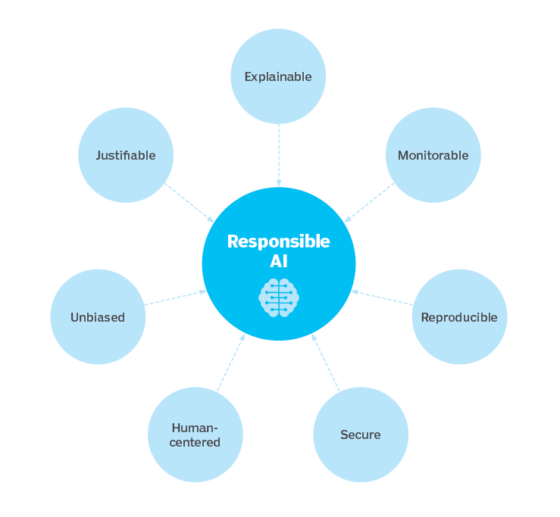
Ethical use
Notes:
While AI tools present a range of new functionality for businesses, the use of artificial intelligence also raises ethical questions because, for better or worse, an AI system will reinforce what it has already learned.
This can be problematic because machine learning algorithms, which underpin many of the most advanced AI tools, are only as smart as the data they are given in training. Because a human being selects what data is used to train an AI program, the potential for machine learning bias is inherent and must be monitored closely.
Anyone looking to use machine learning as part of real-world, in-production systems needs to factor ethics into their AI training processes and strive to avoid bias. This is especially true when using AI algorithms that are inherently unexplainable in deep learning and generative adversarial network (GAN) applications.
Explainability is a potential stumbling block to using AI in industries that operate under strict regulatory compliance requirements. For example, financial institutions in the United States operate under regulations that require them to explain their credit-issuing decisions. When a decision to refuse credit is made by AI programming, however, it can be difficult to explain how the decision was arrived at because the AI tools used to make such decisions operate by teasing out subtle correlations between thousands of variables. When the decision-making process cannot be explained, the program may be referred to as black box AI.
Despite potential risks, there are currently few regulations governing the use of AI tools, and where laws do exist, they typically pertain to AI indirectly. For example, as previously mentioned, United States Fair Lending regulations require financial institutions to explain credit decisions to potential customers. This limits the extent to which lenders can use deep learning algorithms, which by their nature are opaque and lack explainability.
The European Union's General Data Protection Regulation (GDPR) puts strict limits on how enterprises can use consumer data, which impedes the training and functionality of many consumer-facing AI applications.
In October 2016, the National Science and Technology Council issued a report examining the potential role governmental regulation might play in AI development, but it did not recommend specific legislation be considered.
Crafting laws to regulate AI will not be easy, in part because AI comprises a variety of technologies that companies use for different ends, and partly because regulations can come at the cost of AI progress and development. The rapid evolution of AI technologies is another obstacle to forming meaningful regulation of AI. Technology breakthroughs and novel applications can make existing laws instantly obsolete. For example, existing laws regulating the privacy of conversations and recorded conversations do not cover the challenge posed by voice assistants like Amazon's Alexa and Apple's Siri that gather but do not distribute conversation -- except to the companies' technology teams which use it to improve machine learning algorithms. And, of course, the laws that governments do manage to craft to regulate AI don't stop criminals from using the technology with malicious intent.

Slide 18
History of ai
Indian & Greek Gods
The 1940’s
The 1950’s
1956
1950 and 1960’s
1970 and 1980’s
1990 till Today
Notes:
The concept of inanimate objects endowed with intelligence has been around since ancient times. The Greek god Hephaestus was depicted in myths as forging robot-like servants out of gold. Engineers in ancient Egypt built statues of gods animated by priests. Throughout the centuries, thinkers from Aristotle to the 13th century Spanish theologian Ramon Llull to René Descartes and Thomas Bayes used the tools and logic of their times to describe human thought processes as symbols, laying the foundation for AI concepts such as general knowledge representation.
The late 19th and first half of the 20th centuries brought forth the foundational work that would give rise to the modern computer. In 1836, Cambridge University mathematician Charles Babbage and Augusta Ada Byron, Countess of Lovelace, invented the first design for a programmable machine.
1940s. Princeton mathematician John Von Neumann conceived the architecture for the stored-program computer -- the idea that a computer's program and the data it processes can be kept in the computer's memory. And Warren McCulloch and Walter Pitts laid the foundation for neural networks.
1950s. With the advent of modern computers, scientists could test their ideas about machine intelligence. One method for determining whether a computer has intelligence was devised by the British mathematician and World War II code-breaker Alan Turing. The Turing Test focused on a computer's ability to fool interrogators into believing its responses to their questions were made by a human being.
1956. The modern field of artificial intelligence is widely cited as starting this year during a summer conference at Dartmouth College. Sponsored by the Defense Advanced Research Projects Agency (DARPA), the conference was attended by 10 luminaries in the field, including AI pioneers Marvin Minsky, Oliver Selfridge and John McCarthy, who is credited with coining the term artificial intelligence. Also in attendance were Allen Newell, a computer scientist, and Herbert A. Simon, an economist, political scientist and cognitive psychologist, who presented their groundbreaking Logic Theorist, a computer program capable of proving certain mathematical theorems and referred to as the first AI program.
1950s and 1960s. In the wake of the Dartmouth College conference, leaders in the fledgling field of AI predicted that a man-made intelligence equivalent to the human brain was around the corner, attracting major government and industry support. Indeed, nearly 20 years of well-funded basic research generated significant advances in AI: For example, in the late 1950s, Newell and Simon published the General Problem Solver (GPS) algorithm, which fell short of solving complex problems but laid the foundations for developing more sophisticated cognitive architectures; McCarthy developed Lisp, a language for AI programming that is still used today. In the mid-1960s MIT Professor Joseph Weizenbaum developed ELIZA, an early natural language processing program that laid the foundation for today's chatbots.
1970s and 1980s. But the achievement of artificial general intelligence proved elusive, not imminent, hampered by limitations in computer processing and memory and by the complexity of the problem. Government and corporations backed away from their support of AI research, leading to a fallow period lasting from 1974 to 1980 and known as the first "AI Winter." In the 1980s, research on deep learning techniques and industry's adoption of Edward Feigenbaum's expert systems sparked a new wave of AI enthusiasm, only to be followed by another collapse of government funding and industry support. The second AI winter lasted until the mid-1990s.
1990s through today. Increases in computational power and an explosion of data sparked an AI renaissance in the late 1990s that has continued to present times. The latest focus on AI has given rise to breakthroughs in natural language processing, computer vision, robotics, machine learning, deep learning and more. Moreover, AI is becoming ever more tangible, powering cars, diagnosing disease and cementing its role in popular culture. In 1997, IBM's Deep Blue defeated Russian chess grandmaster Garry Kasparov, becoming the first computer program to beat a world chess champion. Fourteen years later, IBM's Watson captivated the public when it defeated two former champions on the game show Jeopardy!. More recently, the historic defeat of 18-time World Go champion Lee Sedol by Google DeepMind's AlphaGo stunned the Go community and marked a major milestone in the development of intelligent machines.

Slide 19
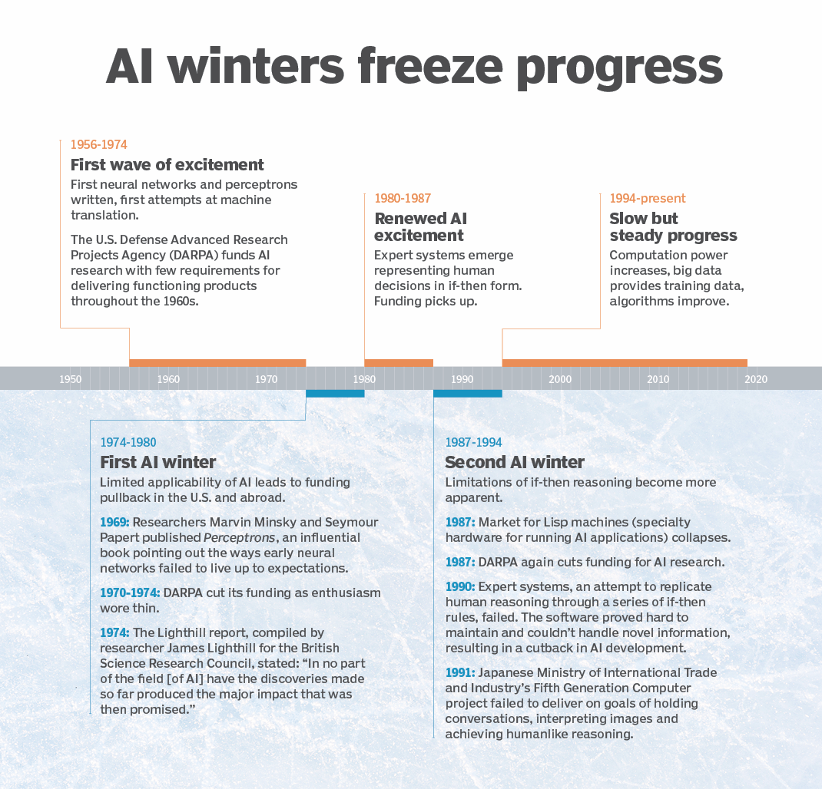
AI WInter

Slide 20
AI as Service
Amazon AI
IBM Watson
Microsoft Cognitive Services
Google AI

Slide 21
Natural language processing
Introduction
How does it work?
Why it is important
Techniques and Methods of NLP
Notes:
Natural language processing (NLP) is the ability of a computer program to understand human language as it is spoken and written -- referred to as natural language. It is a component of artificial intelligence (AI).
NLP has existed for more than 50 years and has roots in the field of linguistics. It has a variety of real-world applications in a number of fields, including medical research, search engines and business intelligence.
Why is natural language processing important?
Businesses use massive quantities of unstructured, text-heavy data and need a way to efficiently process it. A lot of the information created online and stored in databases is natural human language, and until recently, businesses could not effectively analyze this data. This is where natural language processing is useful.
The advantage of natural language processing can be seen when considering the following two statements: "Cloud computing insurance should be part of every service-level agreement," and, "A good SLA ensures an easier night's sleep -- even in the cloud." If a user relies on natural language processing for search, the program will recognize that cloud computing is an entity, that cloud is an abbreviated form of cloud computing and that SLA is an industry acronym for service-level agreement.

Slide 22

How does nlp work?
Tokenization
Stop Word Removal
Lemmatization and Stemming
Part of Speech Tagging
Rules Based System
Machine Learning Based System
Notes:
How does natural language processing work?
NLP enables computers to understand natural language as humans do. Whether the language is spoken or written, natural language processing uses artificial intelligence to take real-world input, process it, and make sense of it in a way a computer can understand. Just as humans have different sensors -- such as ears to hear and eyes to see -- computers have programs to read and microphones to collect audio. And just as humans have a brain to process that input, computers have a program to process their respective inputs. At some point in processing, the input is converted to code that the computer can understand. There are two main phases to natural language processing: data preprocessing and algorithm development.
Data preprocessing involves preparing and "cleaning" text data for machines to be able to analyze it. preprocessing puts data in workable form and highlights features in the text that an algorithm can work with. There are several ways this can be done, including:
Tokenization. This is when text is broken down into smaller units to work with.
Stop word removal. This is when common words are removed from text so unique words that offer the most information about the text remain.
Lemmatization and stemming. This is when words are reduced to their root forms to process.
Part-of-speech tagging. This is when words are marked based on the part-of speech they are -- such as nouns, verbs and adjectives.
Once the data has been preprocessed, an algorithm is developed to process it. There are many different natural language processing algorithms, but two main types are commonly used:
Rules-based system. This system uses carefully designed linguistic rules. This approach was used early on in the development of natural language processing, and is still used.
Machine learning-based system. Machine learning algorithms use statistical methods. They learn to perform tasks based on training data they are fed, and adjust their methods as more data is processed. Using a combination of machine learning, deep learning and neural networks, natural language processing algorithms hone their own rules through repeated processing and learning.

Slide 23
Elements of NLP
Machine Translation
Information Retrieval
Sentiment Analysis
Information Extraction
Question Answering

Slide 24
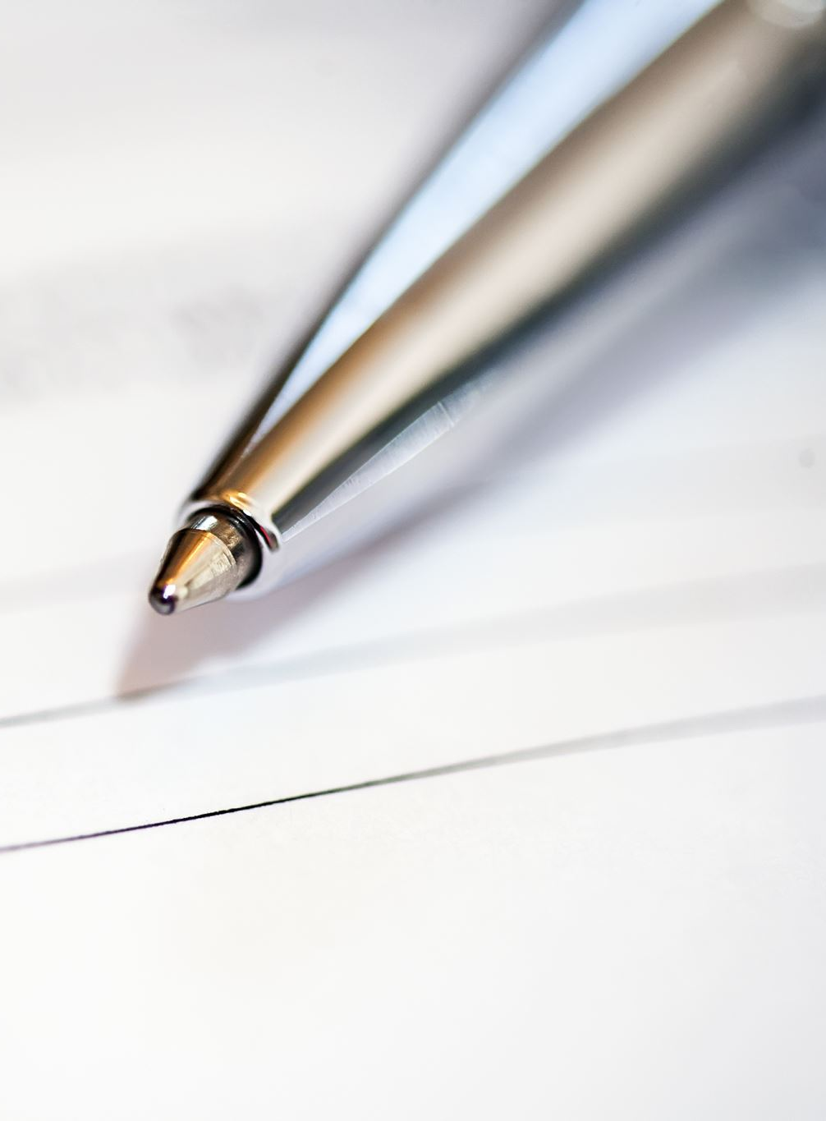
Techniques and methods
Parsing
Word Segmentation
Sentence Breaking
Morphological Segmentation
Stemming
Word sense disambiguation
Named Entity Recognition
Natural Language Generation
Notes:
Parsing. This is the grammatical analysis of a sentence. Example: A natural language processing algorithm is fed the sentence, "The dog barked." Parsing involves breaking this sentence into parts of speech -- i.e., dog = noun, barked = verb. This is useful for more complex downstream processing tasks.
Word segmentation. This is the act of taking a string of text and deriving word forms from it. Example: A person scans a handwritten document into a computer. The algorithm would be able to analyze the page and recognize that the words are divided by white spaces.
Sentence breaking. This places sentence boundaries in large texts. Example: A natural language processing algorithm is fed the text, "The dog barked. I woke up." The algorithm can recognize the period that splits up the sentences using sentence breaking.
Morphological segmentation. This divides words into smaller parts called morphemes. Example: The word untestably would be broken into [[un[[test]able]]ly], where the algorithm recognizes "un," "test," "able" and "ly" as morphemes. This is especially useful in machine translation and speech recognition.
Stemming. This divides words with inflection in them to root forms. Example: In the sentence, "The dog barked," the algorithm would be able to recognize the root of the word "barked" is "bark." This would be useful if a user was analyzing a text for all instances of the word bark, as well as all of its conjugations. The algorithm can see that they are essentially the same word even though the letters are different.
Semantics involves the use of and meaning behind words. Natural language processing applies algorithms to understand the meaning and structure of sentences. Semantics techniques include:
Word sense disambiguation. This derives the meaning of a word based on context. Example: Consider the sentence, "The pig is in the pen." The word pen has different meanings. An algorithm using this method can understand that the use of the word pen here refers to a fenced-in area, not a writing implement.
Named entity recognition. This determines words that can be categorized into groups. Example: An algorithm using this method could analyze a news article and identify all mentions of a certain company or product. Using the semantics of the text, it would be able to differentiate between entities that are visually the same. For instance, in the sentence, "Daniel McDonald's son went to McDonald's and ordered a Happy Meal," the algorithm could recognize the two instances of "McDonald's" as two separate entities -- one a restaurant and one a person.
Natural language generation. This uses a database to determine semantics behind words and generate new text. Example: An algorithm could automatically write a summary of findings from a business intelligence platform, mapping certain words and phrases to features of the data in the BI platform. Another example would be automatically generating news articles or tweets based on a certain body of text used for training.

Slide 25

Use cases
Text Classification
Text Extraction
Machine Translation
Natural Language Generation
Notes:
Text classification. This involves assigning tags to texts to put them in categories. This can be useful for sentiment analysis, which helps the natural language processing algorithm determine the sentiment, or emotion behind a text. For example, when brand A is mentioned in X number of texts, the algorithm can determine how many of those mentions were positive and how many were negative. It can also be useful for intent detection, which helps predict what the speaker or writer may do based on the text they are producing.
Text extraction. This involves automatically summarizing text and finding important pieces of data. One example of this is keyword extraction, which pulls the most important words from the text, which can be useful for search engine optimization. Doing this with natural language processing requires some programming -- it is not completely automated. However, there are plenty of simple keyword extraction tools that automate most of the process -- the user just has to set parameters within the program. For example, a tool might pull out the most frequently used words in the text. Another example is named entity recognition, which extracts the names of people, places and other entities from text.
Machine translation. This is the process by which a computer translates text from one language, such as English, to another language, such as French, without human intervention.
Natural language generation. This involves using natural language processing algorithms to analyze unstructured data and automatically produce content based on that data. One example of this is in language models such as GPT3, which are able to analyze an unstructured text and then generate believable articles based on the text.

Slide 26
Real time applications
Customer Feedback Analysis
Customer Service Automation
Automatic Translation
Academic Research & Analysis
Analysis & Categorization of Medical Records

Slide 27
Benefits
Increases and Improves the HCI
Improved Accuracy and Efficiency of Documentation
Useful for Personal Assistants
Improves Organization to use Chatbot
Easier to perform Sentiment Analysis

Slide 28
Challenges
Precision
Tone of Voice and Inflection
Evolving Use of Language
Notes:
Precision. Computers traditionally require humans to "speak" to them in a programming language that is precise, unambiguous and highly structured -- or through a limited number of clearly enunciated voice commands. Human speech, however, is not always precise; it is often ambiguous and the linguistic structure can depend on many complex variables, including slang, regional dialects and social context.
Tone of voice and inflection. Natural language processing has not yet been perfected. For example, semantic analysis can still be a challenge. Other difficulties include the fact that the abstract use of language is typically tricky for programs to understand. For instance, natural language processing does not pick up sarcasm easily. These topics usually require understanding the words being used and their context in a conversation. As another example, a sentence can change meaning depending on which word or syllable the speaker puts stress on. NLP algorithms may miss the subtle, but important, tone changes in a person's voice when performing speech recognition. The tone and inflection of speech may also vary between different accents, which can be challenging for an algorithm to parse.
Evolving use of language. Natural language processing is also challenged by the fact that language -- and the way people use it -- is continually changing. Although there are rules to language, none are written in stone, and they are subject to change over time. Hard computational rules that work now may become obsolete as the characteristics of real-world language change over time.

Slide 29
Evolution of NLP
1950’s
1950’s to 1990’s
1990’s
2000’s to 2020’s
Notes:
The evolution of natural language processing
NLP draws from a variety of disciplines, including computer science and computational linguistics developments dating back to the mid-20th century. Its evolution included the following major milestones:
1950s. Natural language processing has its roots in this decade, when Alan Turing developed the Turing Test to determine whether or not a computer is truly intelligent. The test involves automated interpretation and the generation of natural language as criterion of intelligence.
1950s-1990s. NLP was largely rules-based, using handcrafted rules developed by linguists to determine how computers would process language.
1990s. The top-down, language-first approach to natural language processing was replaced with a more statistical approach, because advancements in computing made this a more efficient way of developing NLP technology. Computers were becoming faster and could be used to develop rules based on linguistic statistics without a linguist creating all of the rules. Data-driven natural language processing became mainstream during this decade. Natural language processing shifted from a linguist-based approach to an engineer-based approach, drawing on a wider variety of scientific disciplines instead of delving into linguistics.
2000-2020s. Natural language processing saw dramatic growth in popularity as a term. With advances in computing power, natural language processing has also gained numerous real-world applications. Today, approaches to NLP involve a combination of classical linguistics and statistical methods.

Slide 30
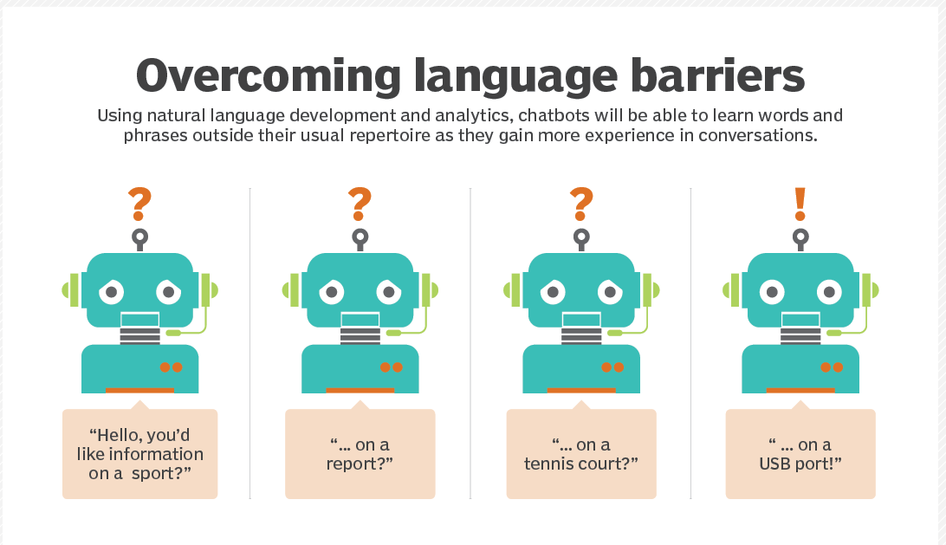
Natural language understanding
Introduction
Working
Overcoming Language Barriers
NLU vs NLP vs NLG
Notes:
Natural language understanding (NLU) is a subfield of natural language processing (NLP), which involves transforming human language into a machine-readable format.
With the help of natural language understanding (NLU) and machine learning, computers can automatically analyze data in seconds, saving businesses countless hours and resources when analyzing troves of customer feedback.
NLU systems work by analysing input text, and using that to determine the meaning behind the user’s request. It does that by matching what’s said to training data that corresponds to an ‘intent’. Identifying that intent is the first job of an NLU.
What is an NLU intent?
An intent is an action that a user intends to perform. You can think of it as the meaning behind what the user said. For example, you might give your taxi chatbot or voicebot a ‘book’ intent if you want to allow your users to book a taxi.
How does an NLU determine an intent?
NLU systems determine the intent by taking the input text written by the user (or transcribed by a speech to text system), and matching that to similar text in its ‘training data’ (more on training data in a moment).
What is NLU training data?
Training data, also called ‘sample utterances’ are simply written examples of the kind of things people are likely to say to a chatbot or voicebot.
The training data is organised into ‘buckets’, with each bucket containing different examples of phrases that have the same or similar meaning. For example: “I’d like a taxi please” and “Book me a ride” could both be examples of training data that you’d put into one ‘bucket’. That’s because both of those phrases mean the same thing: the user wants to book a ride.
Whereas; “How much would it cost?” and “Can I get a quote?” would both be examples of training data that you’d put into a different ‘bucket’. That’s because both of those phrases mean the user is wanting to know how much a ride would cost.
Each ‘bucket’ is given a specific label and that label is, you guessed it, the ‘intent’.
NLP = NLU + NLG
NLU takes up the understanding of the data based on grammar, the context in which it was said and decide on intent and entities.
NLP will convert the text into structured data.
NLG generates text generated based on structured data.

Slide 31
Natural language application
IVR and Message Routing
Customer Support and Service Through Intelligent Personal Assistants
Machine Translation
Data Capture
Conversational Interfaces

Slide 32
Fundamentals 0f ml
Supervised Learning
Unsupervised Learning
Reinforcement Learning
Basic Terminology

Slide 33
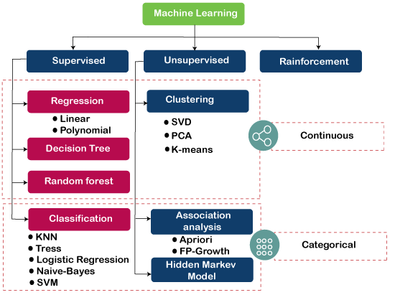
The Specification
Notes:
Supervised learning is a type of Machine learning in which the machine needs external supervision to learn. The supervised learning models are trained using the labeled dataset. Once the training and processing are done, the model is tested by providing a sample test data to check whether it predicts the correct output.
The goal of supervised learning is to map input data with the output data. Supervised learning is based on supervision, and it is the same as when a student learns things in the teacher's supervision. The example of supervised learning is spam filtering.
Supervised learning can be divided further into two categories of problem:
Classification
Regression
Examples of some popular supervised learning algorithms are Simple Linear regression, Decision Tree, Logistic Regression, KNN algorithm, etc
2) Unsupervised Learning Algorithm
It is a type of machine learning in which the machine does not need any external supervision to learn from the data, hence called unsupervised learning. The unsupervised models can be trained using the unlabelled dataset that is not classified, nor categorized, and the algorithm needs to act on that data without any supervision. In unsupervised learning, the model doesn't have a predefined output, and it tries to find useful insights from the huge amount of data. These are used to solve the Association and Clustering problems. Hence further, it can be classified into two types:
Clustering
Association
Examples of some Unsupervised learning algorithms are K-means Clustering, Apriori Algorithm, Eclat, etc. Read more..
3) Reinforcement Learning
In Reinforcement learning, an agent interacts with its environment by producing actions, and learn with the help of feedback. The feedback is given to the agent in the form of rewards, such as for each good action, he gets a positive reward, and for each bad action, he gets a negative reward. There is no supervision provided to the agent. Q-Learning algorithm is used in reinforcement learning.

Slide 34
Setting up google colab

Slide 35
Python basics
Jupyter Notebook
Import Command
Installing Libraries
Input & Output Cells

Slide 36
Introduction to data loading
Data Formats (CSV, JSON, XLSX)
Getting Data Statistics
Handling Missing Data
Data Normalization

Slide 37
Exploratory data analysis
Introduction to Data Analysis
Seaborn
Matplotlib
Generating Basics Graphs
Correlation Maps
Loading & Exploring Dataset
Identifying Patterns & Outliers

Slide 38

Example of basics & EDA

Slide 39
Scikit learn
Introduction
Model Tuning Parameters
Confusion Matrix
F1 Score, Accuracy, Recall, Precision
Overfitting & Underfitting
Notes:
One important thing to consider is the type of algorithm that is giving these results. Each of these metrics is designed for the output of a (binary) classification algorithm. These outputs have a number of records, and for each record there will be a "true" or "false" classification. However, we will discuss how to extend these measurements to other types of output where appropriate.
Briefly, a classification algorithm takes some input set and, for each member of the sets, classifies it as one of a fixed set of outputs. Examples of classification include facial recognition (match or not match), spam filters, and other kinds of pattern recognition with categorical output. Binary classification is a type of classification where there are only two possible outputs. An example of binary classification comes from perhaps the most famous educational data set in data science: the Titanic passenger dataset, where the binary outcome is survival of the disastrous sinking.

Slide 40
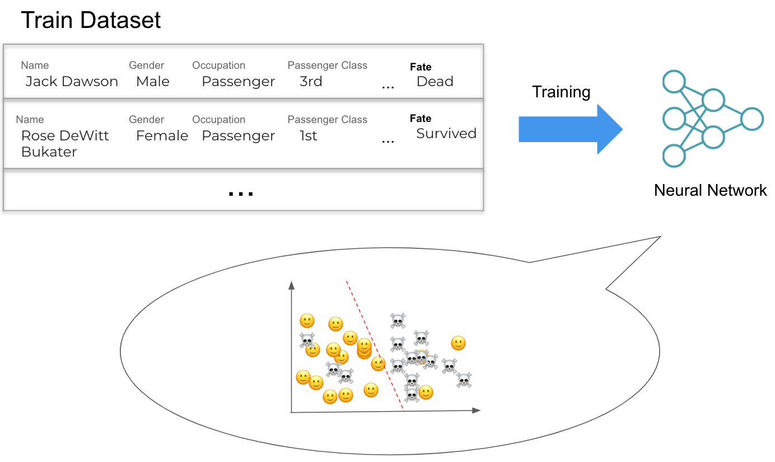
Notes:
One important thing to consider is the type of algorithm that is giving these results. Each of these metrics is designed for the output of a (binary) classification algorithm. These outputs have a number of records, and for each record there will be a "true" or "false" classification. However, we will discuss how to extend these measurements to other types of output where appropriate.
Briefly, a classification algorithm takes some input set and, for each member of the sets, classifies it as one of a fixed set of outputs. Examples of classification include facial recognition (match or not match), spam filters, and other kinds of pattern recognition with categorical output. Binary classification is a type of classification where there are only two possible outputs. An example of binary classification comes from perhaps the most famous educational data set in data science: the Titanic passenger dataset, where the binary outcome is survival of the disastrous sinking.

Slide 41
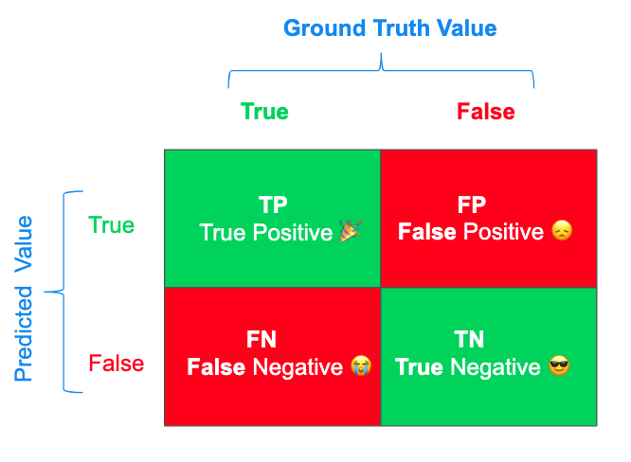
Confusion matrix
Notes:
A "True Positive" (TP), is when the device correctly identifies that a ship is carrying treasure. You raid the ship and share plunder among the crew.
A "False Positive" (FP) is when the device says that a ship has treasure but it is empty. You raid the ship and the crew stages a mutiny over the disappointment of finding it empty.
A "False Negative" (FN) is when the device says that a ship does not have treasure but it actually does. You let the ship pass, but when you get back to port the crew hears of another ship taking the bounty and some defect to the more successful crew.
A "True Negative" (TN) is when the device correctly identifies that the ship is devoid of treasure. Your crew saves their strength as you let the ship pass.

Slide 42
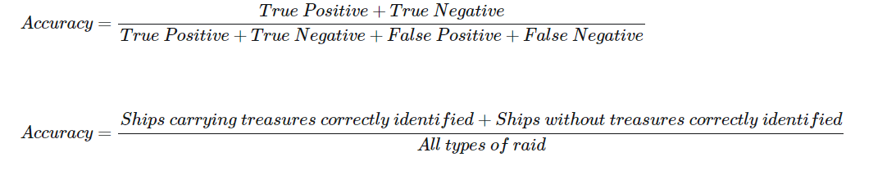
Accuracy

Slide 43
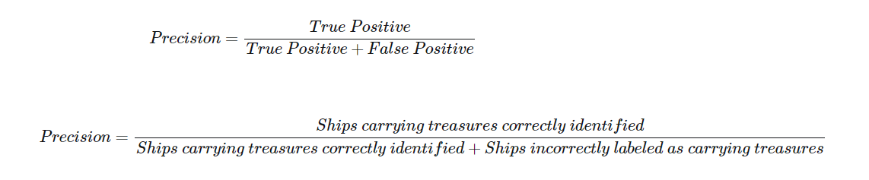
Precision

Slide 44
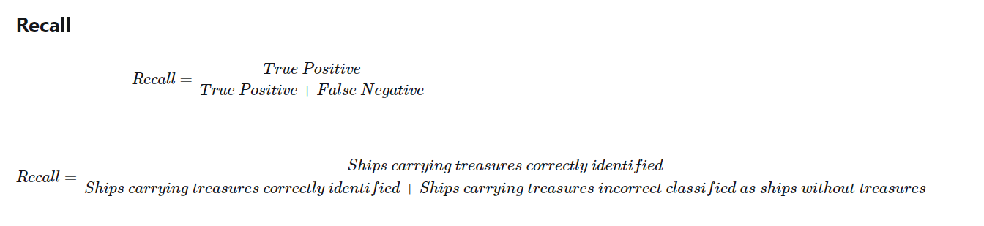
recall

Slide 45
clustering
Introduction
K Nearest Neighbor
Support Vector Machine

Slide 46
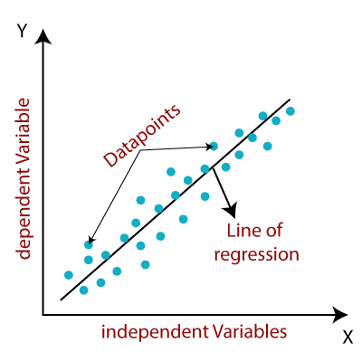
Supervised learning algorithm: Linear regression
Notes:
Linear regression is one of the easiest and most popular Machine Learning algorithms. It is a statistical method that is used for predictive analysis. Linear regression makes predictions for continuous/real or numeric variables such as sales, salary, age, product price, etc.
Linear regression algorithm shows a linear relationship between a dependent (y) and one or more independent (y) variables, hence called as linear regression. Since linear regression shows the linear relationship, which means it finds how the value of the dependent variable is changing according to the value of the independent variable.
The linear regression model provides a sloped straight line representing the relationship between the variables.

Slide 47
Linear regression
y= a0+a1x+ ε
Y= Dependent Variable (Target Variable)
X= Independent Variable (predictor Variable)
a0= intercept of the line (Gives an additional degree of freedom)
a1 = Linear regression coefficient (scale factor to each input value).
ε = random error

Slide 48
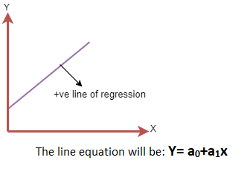
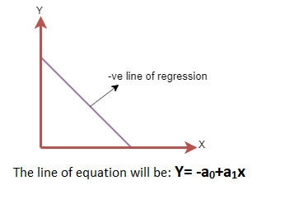
Linear regression
Simple Linear Regression
Multiple Linear regression
Assumptions
Relationship
Notes:
If a single independent variable is used to predict the value of a numerical dependent variable, then such a Linear Regression algorithm is called Simple Linear Regression
If more than one independent variable is used to predict the value of a numerical dependent variable, then such a Linear Regression algorithm is called Multiple Linear Regression.
Positive Linear Relationship: If the dependent variable increases on the Y-axis and independent variable increases on X-axis, then such a relationship is termed as a Positive linear relationship.
Negative Linear Relationship: If the dependent variable decreases on the Y-axis and independent variable increases on the X-axis, then such a relationship is called a negative linear relationship.

Slide 49
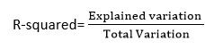
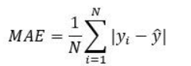
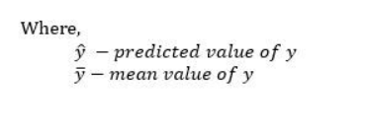
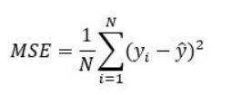
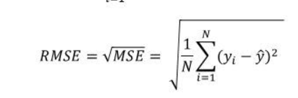
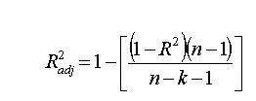
Model performance
R-Squared
MAE
MSE
RMSE
Adjusted R:
Notes:
The Mean absolute error represents the average of the absolute difference between the actual and predicted values in the dataset. It measures the average of the residuals in the dataset.
Mean Squared Error represents the average of the squared difference between the original and predicted values in the data set. It measures the variance of the residuals.
Root Mean Squared Error is the square root of Mean Squared error. It measures the standard deviation of residuals.
The coefficient of determination or R-squared represents the proportion of the variance in the dependent variable which is explained by the linear regression model. It is a scale-free score i.e. irrespective of the values being small or large, the value of R square will be less than one.
Mean Squared Error(MSE) and Root Mean Square Error penalizes the large prediction errors vi-a-vis Mean Absolute Error (MAE). However, RMSE is widely used than MSE to evaluate the performance of the regression model with other random models as it has the same units as the dependent variable (Y-axis).
MSE is a differentiable function that makes it easy to perform mathematical operations in comparison to a non-differentiable function like MAE. Therefore, in many models, RMSE is used as a default metric for calculating Loss Function despite being harder to interpret than MAE.
The lower value of MAE, MSE, and RMSE implies higher accuracy of a regression model. However, a higher value of R square is considered desirable.
R Squared & Adjusted R Squared are used for explaining how well the independent variables in the linear regression model explains the variability in the dependent variable. R Squared value always increases with the addition of the independent variables which might lead to the addition of the redundant variables in our model. However, the adjusted R-squared solves this problem.
Adjusted R squared takes into account the number of predictor variables, and it is used to determine the number of independent variables in our model. The value of Adjusted R squared decreases if the increase in the R square by the additional variable isn’t significant enough.
For comparing the accuracy among different linear regression models, RMSE is a better choice than R Squared.

Slide 50



Train, Validation and Test Dataset
Learn
(Train)
Practice by doing Exercise
(Validate)
Take Exam
(Test)
Notes:
We will only focus on supervised and unsupervised learning algorithms

Slide 51
Train, Validation and Test Dataset
Learn
(Train)
Practice by doing Exercise
(Validate)
Take Exam
(Test)
Notes:
We will only focus on supervised and unsupervised learning algorithms

Slide 52
Train, Validation and Test Dataset
Learn
(Train)
Practice by doing Exercise
(Validate)
Take Exam
(Test)
Notes:
We will only focus on supervised and unsupervised learning algorithms

Slide 53

Example of linear regression

Slide 54

Supervised learning algorithm: Clustering

Slide 55
clustering
K-Nearest Neighbor
Support Vector Machine
Logistics Regression
Navie Bayes

Slide 56
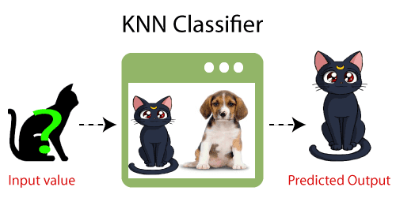
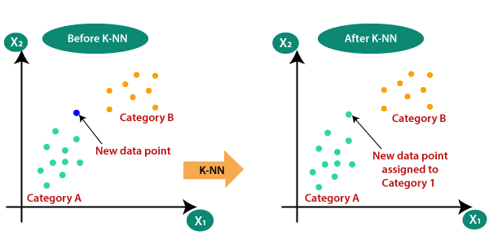
KNN
Introduction
Why We Need KNN?
How Does it Work?
How to select value of K?
Advantages & Disadvantages
Notes:
K-Nearest Neighbour is one of the simplest Machine Learning algorithms based on Supervised Learning technique.
K-NN algorithm assumes the similarity between the new case/data and available cases and put the new case into the category that is most similar to the available categories.
K-NN algorithm stores all the available data and classifies a new data point based on the similarity. This means when new data appears then it can be easily classified into a well suite category by using K- NN algorithm.
K-NN algorithm can be used for Regression as well as for Classification but mostly it is used for the Classification problems.
K-NN is a non-parametric algorithm, which means it does not make any assumption on underlying data.
It is also called a lazy learner algorithm because it does not learn from the training set immediately instead it stores the dataset and at the time of classification, it performs an action on the dataset.
KNN algorithm at the training phase just stores the dataset and when it gets new data, then it classifies that data into a category that is much similar to the new data.
Example: Suppose, we have an image of a creature that looks similar to cat and dog, but we want to know either it is a cat or dog. So for this identification, we can use the KNN algorithm, as it works on a similarity measure. Our KNN model will find the similar features of the new data set to the cats and dogs images and based on the most similar features it will put it in either cat or dog category.
Suppose there are two categories, i.e., Category A and Category B, and we have a new data point x1, so this data point will lie in which of these categories. To solve this type of problem, we need a K-NN algorithm. With the help of K-NN, we can easily identify the category or class of a particular dataset. Consider the below diagram:
How does K-NN work?
The K-NN working can be explained on the basis of the below algorithm:
Step-1: Select the number K of the neighbors
Step-2: Calculate the Euclidean distance of K number of neighbors
Step-3: Take the K nearest neighbors as per the calculated Euclidean distance.
Step-4: Among these k neighbors, count the number of the data points in each category.
Step-5: Assign the new data points to that category for which the number of the neighbor is maximum.
Step-6: Our model is ready.
How to select the value of K in the K-NN Algorithm?
Below are some points to remember while selecting the value of K in the K-NN algorithm:
There is no particular way to determine the best value for "K", so we need to try some values to find the best out of them. The most preferred value for K is 5.
A very low value for K such as K=1 or K=2, can be noisy and lead to the effects of outliers in the model.
Large values for K are good, but it may find some difficulties.
Advantages of KNN Algorithm:
It is simple to implement.
It is robust to the noisy training data
It can be more effective if the training data is large.
Disadvantages of KNN Algorithm:
Always needs to determine the value of K which may be complex some time.
The computation cost is high because of calculating the distance between the data points for all the training samples.

Slide 57
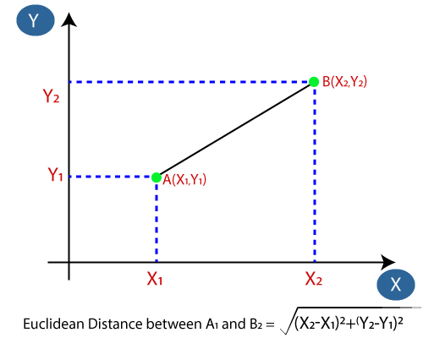
Working

Slide 58
Exmple of KNN

Slide 59

Naïve Bayes Classifier Algorithm

Slide 60
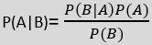
NB
Introduction
Why is it called NB?
Bayes Theorem
Advantages
Disadvantages
Notes:
Naïve Bayes Classifier Algorithm
Naïve Bayes algorithm is a supervised learning algorithm, which is based on Bayes theorem and used for solving classification problems.
It is mainly used in text classification that includes a high-dimensional training dataset.
Naïve Bayes Classifier is one of the simple and most effective Classification algorithms which helps in building the fast machine learning models that can make quick predictions.
It is a probabilistic classifier, which means it predicts on the basis of the probability of an object.
Some popular examples of Naïve Bayes Algorithm are spam filtration, Sentimental analysis, and classifying articles.
Why is it called Naïve Bayes?
The Naïve Bayes algorithm is comprised of two words Naïve and Bayes, Which can be described as:
Naïve: It is called Naïve because it assumes that the occurrence of a certain feature is independent of the occurrence of other features. Such as if the fruit is identified on the bases of color, shape, and taste, then red, spherical, and sweet fruit is recognized as an apple. Hence each feature individually contributes to identify that it is an apple without depending on each other.
Bayes: It is called Bayes because it depends on the principle of Bayes' Theorem.
Bayes' Theorem:
Bayes' theorem is also known as Bayes' Rule or Bayes' law, which is used to determine the probability of a hypothesis with prior knowledge. It depends on the conditional probability.
The formula for Bayes' theorem is given as:
Where,
P(A|B) is Posterior probability: Probability of hypothesis A on the observed event B.
P(B|A) is Likelihood probability: Probability of the evidence given that the probability of a hypothesis is true.
P(A) is Prior Probability: Probability of hypothesis before observing the evidence.
P(B) is Marginal Probability: Probability of Evidence.
Advantages of Naïve Bayes Classifier:
Naïve Bayes is one of the fast and easy ML algorithms to predict a class of datasets.
It can be used for Binary as well as Multi-class Classifications.
It performs well in Multi-class predictions as compared to the other Algorithms.
It is the most popular choice for text classification problems.
Disadvantages of Naïve Bayes Classifier:
Naive Bayes assumes that all features are independent or unrelated, so it cannot learn the relationship between features.
Applications of Naïve Bayes Classifier:
It is used for Credit Scoring.
It is used in medical data classification.
It can be used in real-time predictions because Naïve Bayes Classifier is an eager learner.
It is used in Text classification such as Spam filtering and Sentiment analysis.
Types of Naïve Bayes Model:
There are three types of Naive Bayes Model, which are given below:
Gaussian: The Gaussian model assumes that features follow a normal distribution. This means if predictors take continuous values instead of discrete, then the model assumes that these values are sampled from the Gaussian distribution.
Multinomial: The Multinomial Naïve Bayes classifier is used when the data is multinomial distributed. It is primarily used for document classification problems, it means a particular document belongs to which category such as Sports, Politics, education, etc. The classifier uses the frequency of words for the predictors.
Bernoulli: The Bernoulli classifier works similar to the Multinomial classifier, but the predictor variables are the independent Booleans variables. Such as if a particular word is present or not in a document. This model is also famous for document classification tasks.

Slide 61
Example of NB

Slide 62

Logistic regression
Introduction
Basics
Types
Notes:
Logistic regression is one of the most popular Machine Learning algorithms, which comes under the Supervised Learning technique. It is used for predicting the categorical dependent variable using a given set of independent variables.
Logistic regression predicts the output of a categorical dependent variable. Therefore the outcome must be a categorical or discrete value. It can be either Yes or No, 0 or 1, true or False, etc. but instead of giving the exact value as 0 and 1, it gives the probabilistic values which lie between 0 and 1.
Logistic Regression is much similar to the Linear Regression except that how they are used. Linear Regression is used for solving Regression problems, whereas Logistic regression is used for solving the classification problems.
In Logistic regression, instead of fitting a regression line, we fit an "S" shaped logistic function, which predicts two maximum values (0 or 1).
The curve from the logistic function indicates the likelihood of something such as whether the cells are cancerous or not, a mouse is obese or not based on its weight, etc.
Logistic Regression is a significant machine learning algorithm because it has the ability to provide probabilities and classify new data using continuous and discrete datasets.
Logistic Regression can be used to classify the observations using different types of data and can easily determine the most effective variables used for the classification. The below image is showing the logistic function:
Logistic Function (Sigmoid Function):
The sigmoid function is a mathematical function used to map the predicted values to probabilities.
It maps any real value into another value within a range of 0 and 1.
The value of the logistic regression must be between 0 and 1, which cannot go beyond this limit, so it forms a curve like the "S" form. The S-form curve is called the Sigmoid function or the logistic function.
In logistic regression, we use the concept of the threshold value, which defines the probability of either 0 or 1. Such as values above the threshold value tends to 1, and a value below the threshold values tends to 0.
Type of Logistic Regression:
On the basis of the categories, Logistic Regression can be classified into three types:
Binomial: In binomial Logistic regression, there can be only two possible types of the dependent variables, such as 0 or 1, Pass or Fail, etc.
Multinomial: In multinomial Logistic regression, there can be 3 or more possible unordered types of the dependent variable, such as "cat", "dogs", or "sheep"
Ordinal: In ordinal Logistic regression, there can be 3 or more possible ordered types of dependent variables, such as "low", "Medium", or "High".

Slide 63
Example of logistics Regression

Slide 64

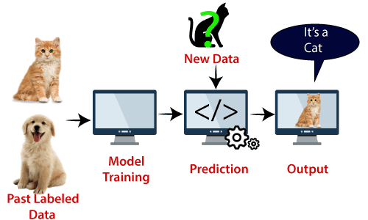
Support vector machine
Introduction
Types
Notes:
Support Vector Machine or SVM is one of the most popular Supervised Learning algorithms, which is used for Classification as well as Regression problems. However, primarily, it is used for Classification problems in Machine Learning.
The goal of the SVM algorithm is to create the best line or decision boundary that can segregate n-dimensional space into classes so that we can easily put the new data point in the correct category in the future. This best decision boundary is called a hyperplane.
SVM chooses the extreme points/vectors that help in creating the hyperplane. These extreme cases are called as support vectors, and hence algorithm is termed as Support Vector Machine. Consider the below diagram in which there are two different categories that are classified using a decision boundary or hyperplane:
Example: SVM can be understood with the example that we have used in the KNN classifier. Suppose we see a strange cat that also has some features of dogs, so if we want a model that can accurately identify whether it is a cat or dog, so such a model can be created by using the SVM algorithm. We will first train our model with lots of images of cats and dogs so that it can learn about different features of cats and dogs, and then we test it with this strange creature. So as support vector creates a decision boundary between these two data (cat and dog) and choose extreme cases (support vectors), it will see the extreme case of cat and dog. On the basis of the support vectors, it will classify it as a cat. Consider the below diagram:
Types of SVM
SVM can be of two types:
Linear SVM: Linear SVM is used for linearly separable data, which means if a dataset can be classified into two classes by using a single straight line, then such data is termed as linearly separable data, and classifier is used called as Linear SVM classifier.
Non-linear SVM: Non-Linear SVM is used for non-linearly separated data, which means if a dataset cannot be classified by using a straight line, then such data is termed as non-linear data and classifier used is called as Non-linear SVM classifier.
Hyperplane and Support Vectors in the SVM algorithm:
Hyperplane: There can be multiple lines/decision boundaries to segregate the classes in n-dimensional space, but we need to find out the best decision boundary that helps to classify the data points. This best boundary is known as the hyperplane of SVM.
The dimensions of the hyperplane depend on the features present in the dataset, which means if there are 2 features (as shown in image), then hyperplane will be a straight line. And if there are 3 features, then hyperplane will be a 2-dimension plane.
We always create a hyperplane that has a maximum margin, which means the maximum distance between the data points.
Support Vectors:
The data points or vectors that are the closest to the hyperplane and which affect the position of the hyperplane are termed as Support Vector. Since these vectors support the hyperplane, hence called a Support vector.

Slide 65
Example of logistics SVM

Slide 66

End of day 1
Any Questions?
Any Inputs

Slide 67
Day 2
Recap of Day 1
Unsupervised Learning Algorithms
Clustering: K-means
Association Analysis: Apriori
Decision Tree
Introduction to Deep Learning
Neurons
Types of Networks: MLP, FFNN, Backpropagation
Activation Functions
Saddle Point & Local Minima Problem

Slide 68
Day 2
Building a Simple Feedforward Neural Network
Defining Layers, Activation Functions & Loss Functions
Introduction to CNN
Understanding the CNN & its Applications
Feature Extraction & Hierarchical Pattern Recognition
Introduction to RNN
Introduction to Sequence Models

Slide 69
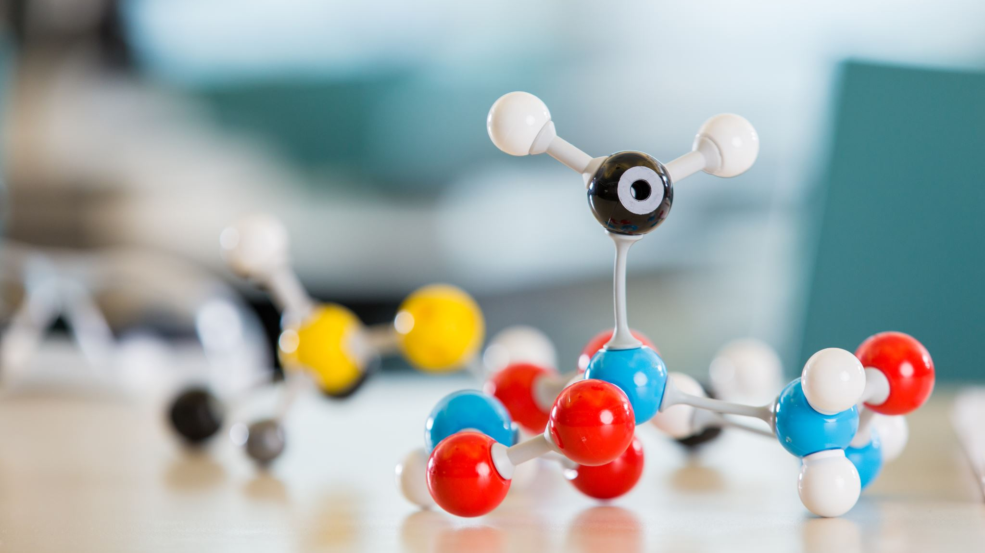
Unsupervised learning models
Clustering: K-Means

Slide 70
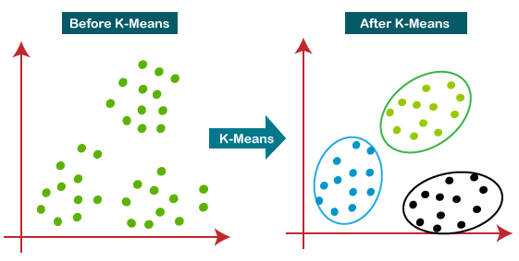
K-Means Clustering
Introduction
What is K-Means?
Working
Elbow Method
Notes:
K-Means Clustering Algorithm
K-Means Clustering is an unsupervised learning algorithm that is used to solve the clustering problems in machine learning or data science. In this topic, we will learn what is K-means clustering algorithm, how the algorithm works, along with the Python implementation of k-means clustering.
What is K-Means Algorithm?
K-Means Clustering is an Unsupervised Learning algorithm, which groups the unlabeled dataset into different clusters. Here K defines the number of pre-defined clusters that need to be created in the process, as if K=2, there will be two clusters, and for K=3, there will be three clusters, and so on.
It is an iterative algorithm that divides the unlabeled dataset into k different clusters in such a way that each dataset belongs only one group that has similar properties.It allows us to cluster the data into different groups and a convenient way to discover the categories of groups in the unlabeled dataset on its own without the need for any training.
It is a centroid-based algorithm, where each cluster is associated with a centroid. The main aim of this algorithm is to minimize the sum of distances between the data point and their corresponding clusters.
The algorithm takes the unlabeled dataset as input, divides the dataset into k-number of clusters, and repeats the process until it does not find the best clusters. The value of k should be predetermined in this algorithm.
The k-means clustering algorithm mainly performs two tasks:
Determines the best value for K center points or centroids by an iterative process.
Assigns each data point to its closest k-center. Those data points which are near to the particular k-center, create a cluster.
Hence each cluster has datapoints with some commonalities, and it is away from other clusters.
How does the K-Means Algorithm Work?
The working of the K-Means algorithm is explained in the below steps:
Step-1: Select the number K to decide the number of clusters.
Step-2: Select random K points or centroids. (It can be other from the input dataset).
Step-3: Assign each data point to their closest centroid, which will form the predefined K clusters.
Step-4: Calculate the variance and place a new centroid of each cluster.
Step-5: Repeat the third steps, which means reassign each datapoint to the new closest centroid of each cluster.
Step-6: If any reassignment occurs, then go to step-4 else go to FINISH.
Step-7: The model is ready.
Let's understand the above steps by considering the visual plots:
Suppose we have two variables M1 and M2. The x-y axis scatter plot of these two variables is given below:

Slide 71
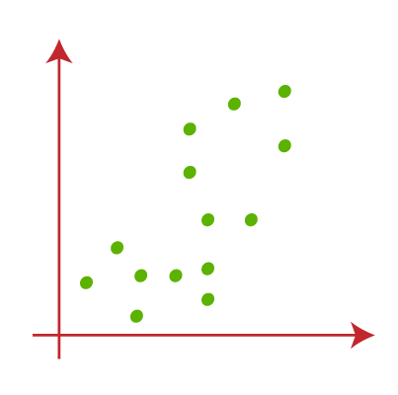
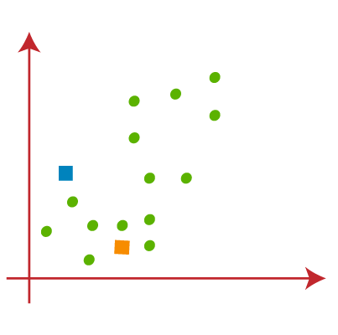
Working
Notes:
Suppose we have two variables M1 and M2. The x-y axis scatter plot of these two variables is given below:
Let's take number k of clusters, i.e., K=2, to identify the dataset and to put them into different clusters. It means here we will try to group these datasets into two different clusters.
We need to choose some random k points or centroid to form the cluster. These points can be either the points from the dataset or any other point. So, here we are selecting the below two points as k points, which are not the part of our dataset. Consider the below image:

Slide 72
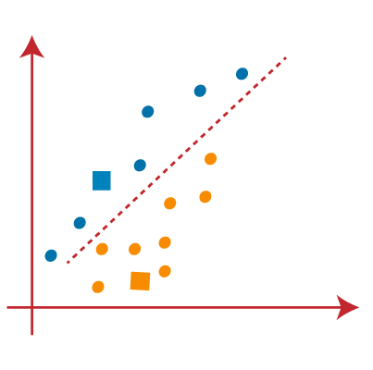
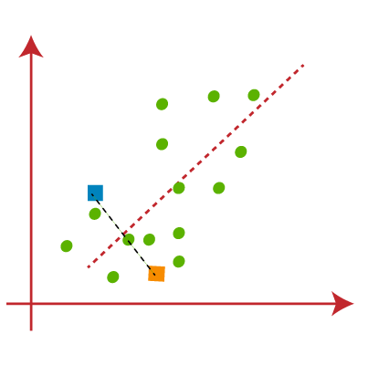
Notes:
Now we will assign each data point of the scatter plot to its closest K-point or centroid. We will compute it by applying some mathematics that we have studied to calculate the distance between two points. So, we will draw a median between both the centroids. Consider the below image:
From the above image, it is clear that points left side of the line is near to the K1 or blue centroid, and points to the right of the line are close to the yellow centroid. Let's color them as blue and yellow for clear visualization

Slide 73
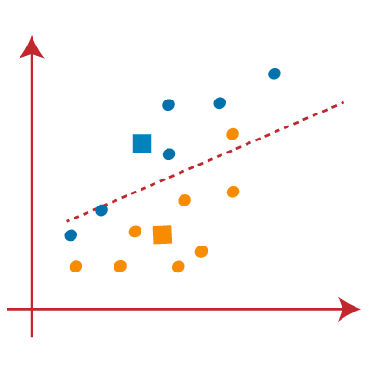
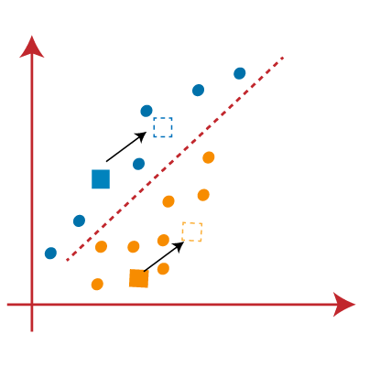
Notes:
As we need to find the closest cluster, so we will repeat the process by choosing a new centroid. To choose the new centroids, we will compute the center of gravity of these centroids, and will find new centroids as below:
Next, we will reassign each datapoint to the new centroid. For this, we will repeat the same process of finding a median line. The median will be like below image:

Slide 74
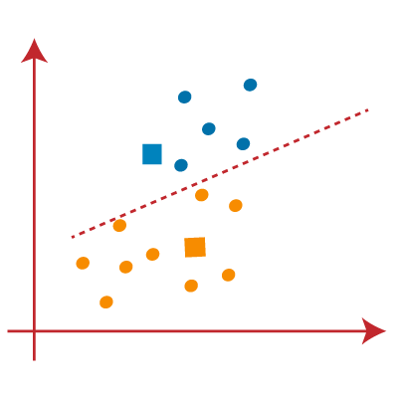
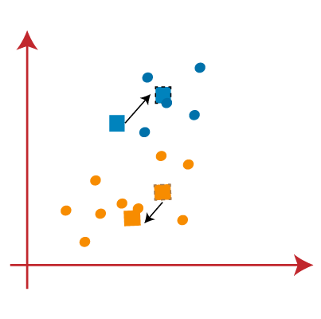
Notes:
From the above image, we can see, one yellow point is on the left side of the line, and two blue points are right to the line. So, these three points will be assigned to new centroids.
As reassignment has taken place, so we will again go to the step-4, which is finding new centroids or K-points.
We will repeat the process by finding the center of gravity of centroids, so the new centroids will be as shown in the below image:

Slide 75
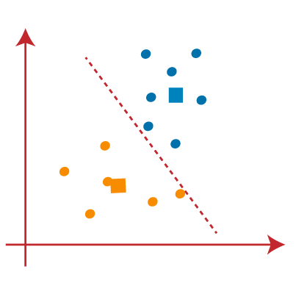
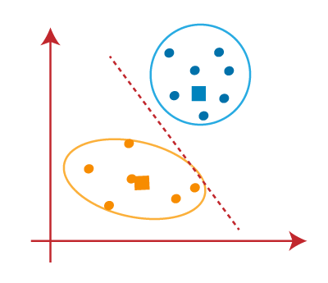
Notes:
As we got the new centroids so again will draw the median line and reassign the data points. So, the image will be:

Slide 76
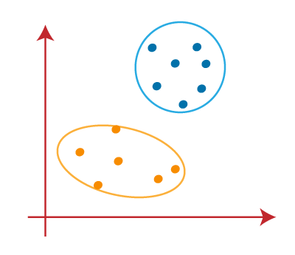
Final Output

Slide 77
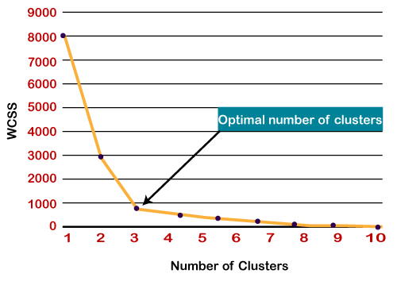
Elbow method
WCSS
WCSS= ∑_{Pi in Cluster1} distance(P_{i} C₁)² +∑_{Pi in Cluster2}distance(P_{i} C₂)²+∑_{Pi in Cluster3} distance(P_{i} C₃)²
Notes:
The Elbow method is one of the most popular ways to find the optimal number of clusters. This method uses the concept of WCSS value. WCSS stands for Within Cluster Sum of Squares, which defines the total variations within a cluster. The formula to calculate the value of WCSS (for 3 clusters) is given below:
In the above formula of WCSS,
∑_{Pi in Cluster1} distance(P_{i} C₁)²: It is the sum of the square of the distances between each data point and its centroid within a cluster1 and the same for the other two terms.
To measure the distance between data points and centroid, we can use any method such as Euclidean distance or Manhattan distance.
To find the optimal value of clusters, the elbow method follows the below steps:
It executes the K-means clustering on a given dataset for different K values (ranges from 1-10).
For each value of K, calculates the WCSS value.
Plots a curve between calculated WCSS values and the number of clusters K.
The sharp point of bend or a point of the plot looks like an arm, then that point is considered as the best value of K.
Since the graph shows the sharp bend, which looks like an elbow, hence it is known as the elbow method. The graph for the elbow method looks like the below image:

Slide 78
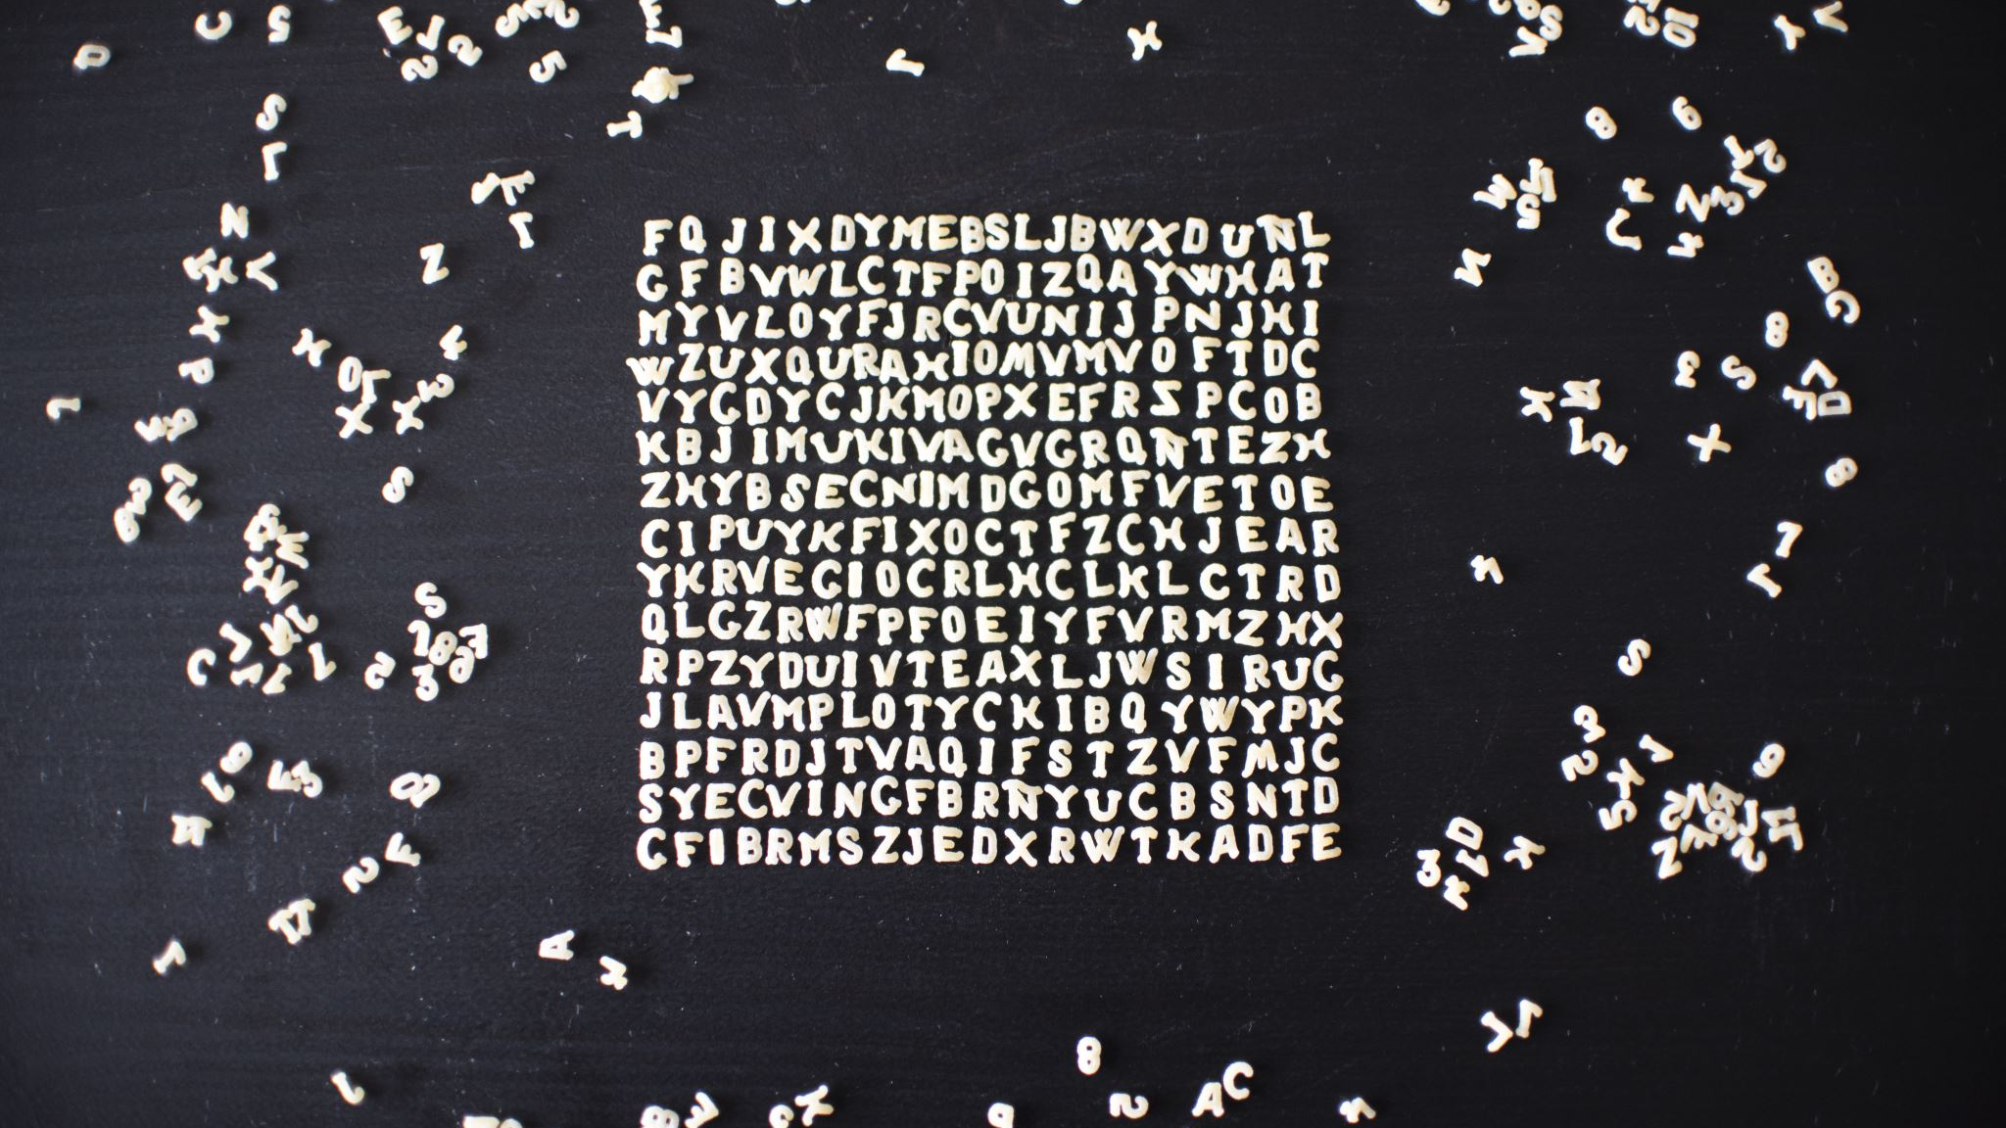
Example of k-means

Slide 79

Association analysis
Apriori

Slide 80
Apriori Algorithm in Machine Learning
Introduction
Frequent Item Set
Support & Confidence
Steps & Working
Notes:
The Apriori algorithm uses frequent itemsets to generate association rules, and it is designed to work on the databases that contain transactions. With the help of these association rule, it determines how strongly or how weakly two objects are connected. This algorithm uses a breadth-first search and Hash Tree to calculate the itemset associations efficiently. It is the iterative process for finding the frequent itemsets from the large dataset.
This algorithm was given by the R. Agrawal and Srikant in the year 1994. It is mainly used for market basket analysis and helps to find those products that can be bought together. It can also be used in the healthcare field to find drug reactions for patients.
What is Frequent Itemset?
Frequent itemsets are those items whose support is greater than the threshold value or user-specified minimum support. It means if A & B are the frequent itemsets together, then individually A and B should also be the frequent itemset.
Suppose there are the two transactions: A= {1,2,3,4,5}, and B= {2,3,7}, in these two transactions, 2 and 3 are the frequent itemsets.
Support is a measure of how frequently an itemset (a set of items) appears in the dataset. It indicates the proportion of transactions in which the itemset occurs.
Confidence: Confidence measures how often a certain association rule holds true. An association rule has the form "If A then B," where A and B are itemsets. Confidence quantifies the likelihood that itemset B will appear in a transaction given that itemset A appears in the same transaction. Mathematically, the confidence of a rule A → B is
Support is like checking how popular something is among a group. Imagine you have a group of friends, and you want to know how many of them like pizza. If 8 out of 10 friends like pizza, then the support for "pizza" is 8 out of 10, or 80%. It tells you how common or popular the thing (like pizza) is in the group.
Confidence is about making predictions based on what you know. Let's say you notice that every time your friend Jane eats pizza (A), she also orders a drink (B). Confidence is a way to measure how often your prediction about Jane's drink choice is correct. If you find that out of 10 times Jane eats pizza (A), she orders a drink (B) 9 times, then the confidence is 90%. This means that when Jane eats pizza, there's a pretty good chance she'll also order a drink.

Slide 81

Decision tree
Introduction
Why use DT?
Terminologies
Notes:
Decision Tree is a Supervised learning technique that can be used for both classification and Regression problems, but mostly it is preferred for solving Classification problems. It is a tree-structured classifier, where internal nodes represent the features of a dataset, branches represent the decision rules and each leaf node represents the outcome.
In a Decision tree, there are two nodes, which are the Decision Node and Leaf Node. Decision nodes are used to make any decision and have multiple branches, whereas Leaf nodes are the output of those decisions and do not contain any further branches.
The decisions or the test are performed on the basis of features of the given dataset.
It is a graphical representation for getting all the possible solutions to a problem/decision based on given conditions.
It is called a decision tree because, similar to a tree, it starts with the root node, which expands on further branches and constructs a tree-like structure.
In order to build a tree, we use the CART algorithm, which stands for Classification and Regression Tree algorithm.
A decision tree simply asks a question, and based on the answer (Yes/No), it further split the tree into subtrees.
Below diagram explains the general structure of a decision tree:
Why use Decision Trees?
There are various algorithms in Machine learning, so choosing the best algorithm for the given dataset and problem is the main point to remember while creating a machine learning model. Below are the two reasons for using the Decision tree:
Decision Trees usually mimic human thinking ability while making a decision, so it is easy to understand.
The logic behind the decision tree can be easily understood because it shows a tree-like structure.
Decision Tree Terminologies
Root Node: Root node is from where the decision tree starts. It represents the entire dataset, which further gets divided into two or more homogeneous sets.Leaf Node: Leaf nodes are the final output node, and the tree cannot be segregated further after getting a leaf node.Splitting: Splitting is the process of dividing the decision node/root node into sub-nodes according to the given conditions.Branch/Sub Tree: A tree formed by splitting the tree.Pruning: Pruning is the process of removing the unwanted branches from the tree.Parent/Child node: The root node of the tree is called the parent node, and other nodes are called the child nodes.

Slide 82
DT Working
Step-1: Begin the tree with the root node, says S, which contains the complete dataset.
Step-2: Find the best attribute in the dataset using Attribute Selection Measure (ASM).
Step-3: Divide the S into subsets that contains possible values for the best attributes.
Step-4: Generate the decision tree node, which contains the best attribute.
Step-5: Recursively make new decision trees using the subsets of the dataset created in step -3. Continue this process until a stage is reached where you cannot further classify the nodes and called the final node as a leaf node.

Slide 83
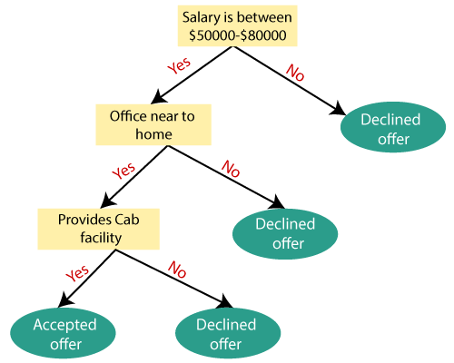
Dt example
Notes:
Suppose there is a candidate who has a job offer and wants to decide whether he should accept the offer or Not. So, to solve this problem, the decision tree starts with the root node (Salary attribute by ASM). The root node splits further into the next decision node (distance from the office) and one leaf node based on the corresponding labels. The next decision node further gets split into one decision node (Cab facility) and one leaf node. Finally, the decision node splits into two leaf nodes (Accepted offers and Declined offer). Consider the below diagram:

Slide 84
Attribute Selection Measures
Entropy
Entropy(s)= -P(yes)log2 P(yes)- P(no) log2 P(no)
Where,
S= Total number of samples
P(yes)= probability of yes
P(no)= probability of no
Information Gain
Information Gain= Entropy(S)- [(Weighted Avg) *Entropy(each feature)
Gini Index
Gini Index= 1- ∑_{j}P_{j}²
Notes:
1. Information Gain:
Information gain is the measurement of changes in entropy after the segmentation of a dataset based on an attribute.
It calculates how much information a feature provides us about a class.
According to the value of information gain, we split the node and build the decision tree.
A decision tree algorithm always tries to maximize the value of information gain, and a node/attribute having the highest information gain is split first. It can be calculated using the below formula:
2. Gini Index:
Gini index is a measure of impurity or purity used while creating a decision tree in the CART(Classification and Regression Tree) algorithm.
An attribute with the low Gini index should be preferred as compared to the high Gini index.
It only creates binary splits, and the CART algorithm uses the Gini index to create binary splits.
Gini index can be calculated using the below formula:

Slide 85
Tree optimization method
Pruning
Advantages
Disadvantages
Notes:
Pruning is a process of deleting the unnecessary nodes from a tree in order to get the optimal decision tree.
A too-large tree increases the risk of overfitting, and a small tree may not capture all the important features of the dataset. Therefore, a technique that decreases the size of the learning tree without reducing accuracy is known as Pruning. There are mainly two types of tree pruning technology used:
Advantages of the Decision Tree
It is simple to understand as it follows the same process which a human follow while making any decision in real-life.
It can be very useful for solving decision-related problems.
It helps to think about all the possible outcomes for a problem.
There is less requirement of data cleaning compared to other algorithms.
Disadvantages of the Decision Tree
The decision tree contains lots of layers, which makes it complex.
It may have an overfitting issue, which can be resolved using the Random Forest algorithm.
For more class labels, the computational complexity of the decision tree may increase.

Slide 86

Example of descion tree

Slide 87
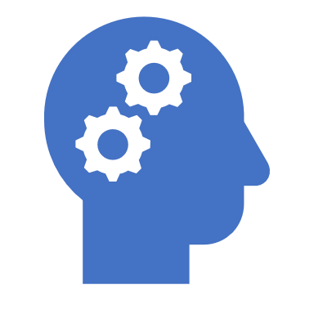
Introduction to deep learning

Slide 88
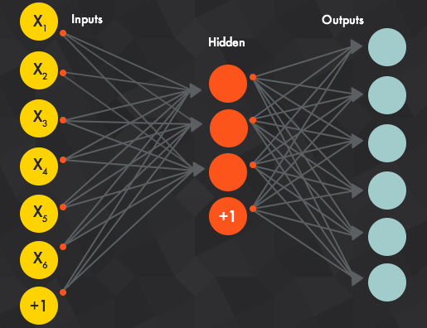
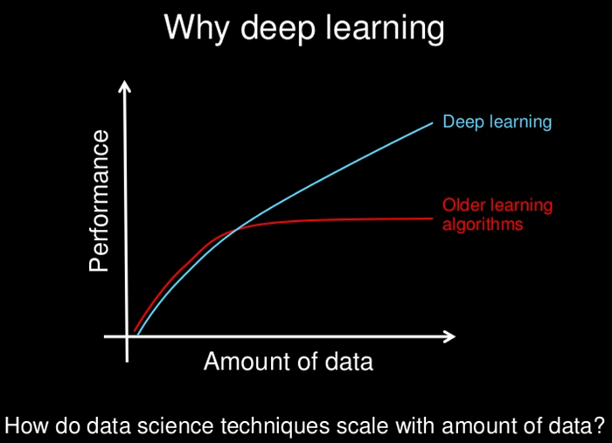

introduction
Notes:
Deep learning is based on the branch of machine learning, which is a subset of artificial intelligence. Since neural networks imitate the human brain and so deep learning will do. In deep learning, nothing is programmed explicitly. Basically, it is a machine learning class that makes use of numerous nonlinear processing units so as to perform feature extraction as well as transformation. The output from each preceding layer is taken as input by each one of the successive layers.
Deep learning models are capable enough to focus on the accurate features themselves by requiring a little guidance from the programmer and are very helpful in solving out the problem of dimensionality. Deep learning algorithms are used, especially when we have a huge no of inputs and outputs.
Since deep learning has been evolved by the machine learning, which itself is a subset of artificial intelligence and as the idea behind the artificial intelligence is to mimic the human behavior, so same is "the idea of deep learning to build such algorithm that can mimic the brain".
Deep learning is implemented with the help of Neural Networks, and the idea behind the motivation of Neural Network is the biological neurons, which is nothing but a brain cell.

Slide 89
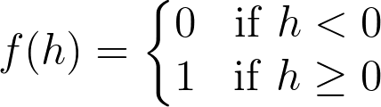
basics
Activation Function
Weights
y = mx+b
Bias
Neural Network
Notes:
Activation functions are functions that decide, given the inputs into the node, what should be the node’s output? Because it’s the activation function that decides the actual output, we often refer to the outputs of a layer as its “activations”.
One of the simplest activation functions is the Heaviside step function. This function returns a 0 if the linear combination is less than 0. It returns a 1 if the linear combination is positive or equal to zero.
When input data comes into a neuron, it gets multiplied by a weight value that is assigned to this particular input. For example, the neuron above university example have two inputs, tests for test scores and grades, so it has two associated weights that can be adjusted individually.
Use of weights
These weights start out as random values, and as the neural network learns more about what kind of input data leads to a student being accepted into a university, the network adjusts the weights based on any errors in categorization that the previous weights resulted in. This is called training the neural network.
Remember we can associate weight as m(slope) in the orginal linear equation.
Weights and biases are the learnable parameters of the deep learning models.
Bias represented as b in the above linear equation.

Slide 90
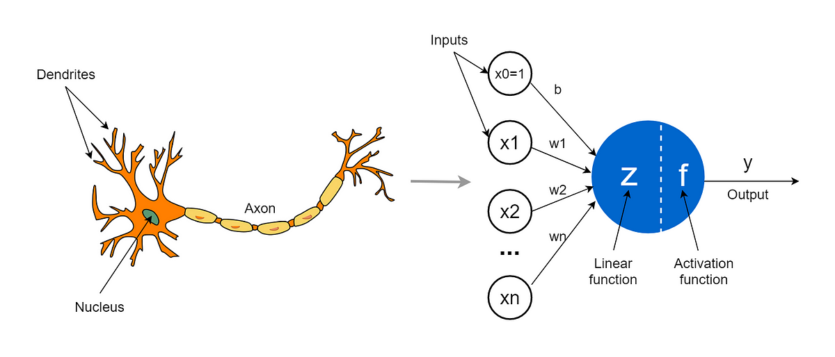
neuron

Slide 91
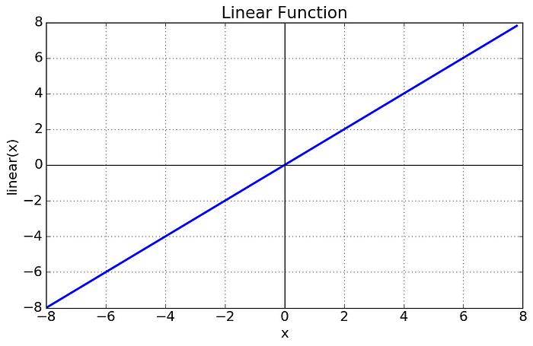
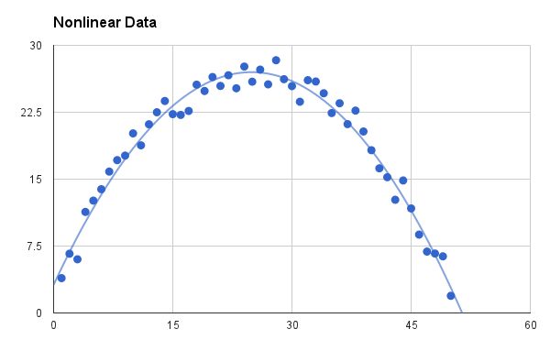
Activation functions
Two Types
Linear
Equation : f(x) = x
Range : (-infinity to infinity)
Non-Linear
Notes:
As you can see the function is a line or linear. Therefore, the output of the functions will not be confined between any range.
The Nonlinear Activation Functions are the most used activation functions. Nonlinearity helps to makes the graph look something like this
It makes it easy for the model to generalize or adapt with variety of data and to differentiate between the output.
The main terminologies needed to understand for nonlinear functions are:
Derivative or Differential: Change in y-axis w.r.t. change in x-axis.It is also known as slope.
Monotonic function: A function which is either entirely non-increasing or non-decreasing.
The Nonlinear Activation Functions are mainly divided on the basis of their range or curves-

Slide 92

Sigmoid
Notes:
The main reason why we use sigmoid function is because it exists between (0 to 1). Therefore, it is especially used for models where we have to predict the probability as an output.Since probability of anything exists only between the range of 0 and 1, sigmoid is the right choice.
The function is differentiable.That means, we can find the slope of the sigmoid curve at any two points.
The function is monotonic but function’s derivative is not.
The logistic sigmoid function can cause a neural network to get stuck at the training time.
The softmax function is a more generalized logistic activation function which is used for multiclass classification.

Slide 93

Tan-h
Notes:
tanh is also like logistic sigmoid but better. The range of the tanh function is from (-1 to 1). tanh is also sigmoidal (s - shaped).
The advantage is that the negative inputs will be mapped strongly negative and the zero inputs will be mapped near zero in the tanh graph.
The function is differentiable.
The function is monotonic while its derivative is not monotonic.
The tanh function is mainly used classification between two classes.
Both tanh and logistic sigmoid activation functions are used in feed-forward nets.

Slide 94

RElU
Notes:
The ReLU is the most used activation function in the world right now.Since, it is used in almost all the convolutional neural networks or deep learning.
As you can see, the ReLU is half rectified (from bottom). f(z) is zero when z is less than zero and f(z) is equal to z when z is above or equal to zero.
Range: [ 0 to infinity)
The function and its derivative both are monotonic.
But the issue is that all the negative values become zero immediately which decreases the ability of the model to fit or train from the data properly. That means any negative input given to the ReLU activation function turns the value into zero immediately in the graph, which in turns affects the resulting graph by not mapping the negative values appropriately.

Slide 95

Leaky relu
Notes:
It is an attempt to solve the dying ReLU problem
Can you see the Leak? 😆
The leak helps to increase the range of the ReLU function. Usually, the value of a is 0.01 or so.
When a is not 0.01 then it is called Randomized ReLU.
Therefore the range of the Leaky ReLU is (-infinity to infinity).
Both Leaky and Randomized ReLU functions are monotonic in nature. Also, their derivatives also monotonic in nature.

Slide 96

Why derivative/differentiation is used ?
Notes:
When updating the curve, to know in which direction and how much to change or update the curve depending upon the slope. That is why we use differentiation in almost every part of Machine Learning and Deep Learning

Slide 97



Saddle point & local minima problem

Slide 98
A little Deep dive
Feed Forward Neural Network
Back Propogation
The XOR Gate Problem
MLP / Multi Layer Perceptron

Slide 99

Building a simple neural network

Slide 100

Introduction to cnn
Notes:
The human brain processes a huge amount of information the second we see an image. Each neuron works in its own receptive field and is connected to other neurons in a way that they cover the entire visual field. Just as each neuron responds to stimuli only in the restricted region of the visual field called the receptive field in the biological vision system, each neuron in a CNN processes data only in its receptive field as well. The layers are arranged in such a way so that they detect simpler patterns first (lines, curves, etc.) and more complex patterns (faces, objects, etc.) further along. By using a CNN, one can enable sight to computers.

Slide 101

Cnn architecture

Slide 102


Convolution layer
Notes:
Convolution Layer
The convolution layer is the core building block of the CNN. It carries the main portion of the network’s computational load.
This layer performs a dot product between two matrices, where one matrix is the set of learnable parameters otherwise known as a kernel, and the other matrix is the restricted portion of the receptive field. The kernel is spatially smaller than an image but is more in-depth. This means that, if the image is composed of three (RGB) channels, the kernel height and width will be spatially small, but the depth extends up to all three channels.
During the forward pass, the kernel slides across the height and width of the image-producing the image representation of that receptive region. This produces a two-dimensional representation of the image known as an activation map that gives the response of the kernel at each spatial position of the image. The sliding size of the kernel is called a stride.
If we have an input of size W x W x D and Dout number of kernels with a spatial size of F with stride S and amount of padding P, then the size of output volume can be determined by the following formula:
Motivation behind Convolution
Convolution leverages three important ideas that motivated computer vision researchers: sparse interaction, parameter sharing, and equivariant representation. Let’s describe each one of them in detail.
Trivial neural network layers use matrix multiplication by a matrix of parameters describing the interaction between the input and output unit. This means that every output unit interacts with every input unit. However, convolution neural networks have sparse interaction. This is achieved by making kernel smaller than the input e.g., an image can have millions or thousands of pixels, but while processing it using kernel we can detect meaningful information that is of tens or hundreds of pixels. This means that we need to store fewer parameters that not only reduces the memory requirement of the model but also improves the statistical efficiency of the model.
If computing one feature at a spatial point (x1, y1) is useful then it should also be useful at some other spatial point say (x2, y2). It means that for a single two-dimensional slice i.e., for creating one activation map, neurons are constrained to use the same set of weights. In a traditional neural network, each element of the weight matrix is used once and then never revisited, while convolution network has shared parameters i.e., for getting output, weights applied to one input are the same as the weight applied elsewhere.
Due to parameter sharing, the layers of convolution neural network will have a property of equivariance to translation. It says that if we changed the input in a way, the output will also get changed in the same way.

Slide 103


Pooling layer
Notes:
The pooling layer replaces the output of the network at certain locations by deriving a summary statistic of the nearby outputs. This helps in reducing the spatial size of the representation, which decreases the required amount of computation and weights. The pooling operation is processed on every slice of the representation individually.
There are several pooling functions such as the average of the rectangular neighborhood, L2 norm of the rectangular neighborhood, and a weighted average based on the distance from the central pixel. However, the most popular process is max pooling, which reports the maximum output from the neighborhood.
If we have an activation map of size W x W x D, a pooling kernel of spatial size F, and stride S, then the size of output volume can be determined by the following formula:

Slide 104
Key points
Fully Connected Layer
Non-Linearity Layers
There are several types of non-linear operations, the popular ones being:
Sigmoid
Tanh
Relu
Notes:
Fully Connected Layer
Neurons in this layer have full connectivity with all neurons in the preceding and succeeding layer as seen in regular FCNN. This is why it can be computed as usual by a matrix multiplication followed by a bias effect.
The FC layer helps to map the representation between the input and the output.
Non-Linearity Layers
Since convolution is a linear operation and images are far from linear, non-linearity layers are often placed directly after the convolutional layer to introduce non-linearity to the activation map.
There are several types of non-linear operations, the popular ones being:
1. Sigmoid
The sigmoid non-linearity has the mathematical form σ(κ) = 1/(1+e¯κ). It takes a real-valued number and “squashes” it into a range between 0 and 1.
However, a very undesirable property of sigmoid is that when the activation is at either tail, the gradient becomes almost zero. If the local gradient becomes very small, then in backpropagation it will effectively “kill” the gradient. Also, if the data coming into the neuron is always positive, then the output of sigmoid will be either all positives or all negatives, resulting in a zig-zag dynamic of gradient updates for weight.
2. Tanh
Tanh squashes a real-valued number to the range [-1, 1]. Like sigmoid, the activation saturates, but — unlike the sigmoid neurons — its output is zero centered.
3. ReLU
The Rectified Linear Unit (ReLU) has become very popular in the last few years. It computes the function ƒ(κ)=max (0,κ). In other words, the activation is simply threshold at zero.
In comparison to sigmoid and tanh, ReLU is more reliable and accelerates the convergence by six times.
Unfortunately, a con is that ReLU can be fragile during training. A large gradient flowing through it can update it in such a way that the neuron will never get further updated. However, we can work with this by setting a proper learning rate.

Slide 105
tensorflow
Introduction
History
Why it is Popular
Use Cases
Notes:
TensorFlow is a popular framework of machine learning and deep learning. It is a free and open-source library which is released on 9 November 2015 and developed by Google Brain Team. It is entirely based on Python programming language and use for numerical computation and data flow, which makes machine learning faster and easier.
TensorFlow can train and run the deep neural networks for image recognition, handwritten digit classification, recurrent neural network, word embedding, natural language processing, video detection, and many more. TensorFlow is run on multiple CPUs or GPUs and also mobile operating systems.
The word TensorFlow is made by two words, i.e., Tensor and Flow
Tensor is a multidimensional array
Flow is used to define the flow of data in operation.
TensorFlow is used to define the flow of data in operation on a multidimensional array or Tensor.
History of TensorFlow
Many years ago, deep learning started to exceed all other machine learning algorithms when giving extensive data. Google has seen it could use these deep neural networks to upgrade its services:
Google search engine
Gmail
Photo
They build a framework called TensorFlow to permit researchers and developers to work together in an AI model. Once it approved and scaled, it allows lots of people to use it.
It was first released in 2015, while the first stable version was coming in 2017. It is an open- source platform under Apache Open Source License. We can use it, modify it, and reorganize the revised version for free without paying anything to Google.
Components of TensorFlow
Tensor
The name TensorFlow is derived from its core framework, "Tensor." A tensor is a vector or a matrix of n-dimensional that represents all type of data. All values in a tensor hold similar data type with a known shape. The shape of the data is the dimension of the matrix or an array.
A tensor can be generated from the input data or the result of a computation. In TensorFlow, all operations are conducted inside a graph. The group is a set of calculation that takes place successively. Each transaction is called an op node are connected.
1. Voice/Sound Recognition
Voice and sound recognition applications are the most-known use cases of deep-learning. If the neural networks have proper input data feed, neural networks are capable of understanding audio signals.
For example:
Voice recognition is used in the Internet of Things, automotive, security, and UX/UI.
Sentiment Analysis is mostly used in customer relationship management (CRM).
Flaw Detection (engine noise) is mostly used in automotive and Aviation.
Voice search is mostly used in customer relationship management (CRM)
2. Image Recognition
Image recognition is the first application that made deep learning and machine learning popular. Telecom, Social Media, and handset manufacturers mostly use image recognition. It is also used for face recognition, image search, motion detection, machine vision, and photo clustering.
For example, image recognition is used to recognize and identify people and objects in from of images. Image recognition is used to understand the context and content of any image.
For object recognition, TensorFlow helps to classify and identify arbitrary objects within larger images.
This is also used in engineering application to identify shape for modeling purpose (3d reconstruction from 2d image) and by Facebook for photo tagging.
For example, deep learning uses TensorFlow for analyzing thousands of photos of cats. So a deep learning algorithm can learn to identify a cat because this algorithm is used to find general features of objects, animals, or people.
3. Time Series
Deep learning is using Time Series algorithms for examining the time series data to extract meaningful statistics. For example, it has used the time series to predict the stock market.
A recommendation is the most common use case for Time Series. Amazon, Google, Facebook, and Netflix are using deep learning for the suggestion. So, the deep learning algorithm is used to analyze customer activity and compare it to millions of other users to determine what the customer may like to purchase or watch.
For example, it can be used to recommend us TV shows or movies that people like based on TV shows or movies we already watched.
4. Video Detection
The deep learning algorithm is used for video detection. It is used for motion detection, real-time threat detection in gaming, security, airports, and UI/UX field.
For example, NASA is developing a deep learning network for object clustering of asteroids and orbit classification. So, it can classify and predict NEOs (Near Earth Objects).
5. Text-Based Applications
Text-based application is also a popular deep learning algorithm. Sentimental analysis, social media, threat detection, and fraud detection, are the example of Text-based applications.
For example, Google Translate supports over 100 languages.
Some companies who are currently using TensorFlow are Google, AirBnb, eBay, Intel, DropBox, Deep Mind, Airbus, CEVA, Snapchat, SAP, Uber, Twitter, Coca-Cola, and IBM.

Slide 106

Features
Notes:
1. Responsive Construct
We can visualize each part of the graph, which is not an option while using Numpy or SciKit. To develop a deep learning application, firstly, there are two or three components that are required to create a deep learning application and need a programming language.
2. Flexible
It is one of the essential TensorFlow Features according to its operability. It has modularity and parts of it which we want to make standalone.
3. Easily Trainable
It is easily trainable on CPU and for GPU in distributed computing.
4. Parallel Neural Network Training
TensorFlow offers to the pipeline in the sense that we can train multiple neural networks and various GPUs, which makes the models very efficient on large-scale systems.
5. Large Community
Google has developed it, and there already is a large team of software engineers who work on stability improvements continuously.
6. Open Source
The best thing about the machine learning library is that it is open source so anyone can use it as much as they have internet connectivity. So, people can manipulate the library and come up with a fantastic variety of useful products. And it has become another DIY community which has a massive forum for people getting started with it and those who find it hard to use it.
7. Feature Columns
TensorFlow has feature columns which could be thought of as intermediates between raw data and estimators; accordingly, bridging input data with our model.
The feature below describes how the feature column is implemented.
8. Availability of Statistical Distributions
This library provides distributions functions including Bernoulli, Beta, Chi2, Uniform, Gamma, which are essential, especially where considering probabilistic approaches such as Bayesian models.
9. Layered Components
TensorFlow produces layered operations of weight and biases from the function such as tf.contrib.layers and also provides batch normalization, convolution layer, and dropout layer. So tf.contrib.layers.optimizers have optimizers such as Adagrad, SGD, Momentum which are often used to solve optimization problems for numerical analysis.
10. Visualizer (With TensorBoard)
We can inspect a different representation of a model and make the changed necessary while debugging it with the help of TensorBoard.
11.Event Logger (With TensorBoard)
It is just like UNIX, where we use tail - f to monitor the output of tasks at the cmd. It checks, logging events and summaries from the graph and production with the TensorBoard.

Slide 107

Simple Example of cnn

Slide 108

Introduction to RNN
Introduction
Architecture
Notes:
RNN works on the principle of saving the output of a particular layer and feeding this back to the input in order to predict the output of the layer.

Slide 109

Notes:
The nodes in different layers of the neural network are compressed to form a single layer of recurrent neural networks. A, B, and C are the parameters of the network.

Slide 110

Notes:
Here, “x” is the input layer, “h” is the hidden layer, and “y” is the output layer. A, B, and C are the network parameters used to improve the output of the model. At any given time t, the current input is a combination of input at x(t) and x(t-1). The output at any given time is fetched back to the network to improve on the output.
Why Recurrent Neural Networks?
RNN were created because there were a few issues in the feed-forward neural network:
Cannot handle sequential data
Considers only the current input
Cannot memorize previous inputs
The solution to these issues is the RNN. An RNN can handle sequential data, accepting the current input data, and previously received inputs. RNNs can memorize previous inputs due to their internal memory.

Slide 111

How Does Recurrent Neural Networks Work?
Notes:
The input layer ‘x’ takes in the input to the neural network and processes it and passes it onto the middle layer.
The middle layer ‘h’ can consist of multiple hidden layers, each with its own activation functions and weights and biases. If you have a neural network where the various parameters of different hidden layers are not affected by the previous layer, ie: the neural network does not have memory, then you can use a recurrent neural network.
The Recurrent Neural Network will standardize the different activation functions and weights and biases so that each hidden layer has the same parameters. Then, instead of creating multiple hidden layers, it will create one and loop over it as many times as required.

Slide 112

Feed-Forward Neural Networks vs Recurrent Neural Networks
Notes:
A feed-forward neural network allows information to flow only in the forward direction, from the input nodes, through the hidden layers, and to the output nodes. There are no cycles or loops in the network.
Below is how a simplified presentation of a feed-forward neural network looks like:
In a feed-forward neural network, the decisions are based on the current input. It doesn’t memorize the past data, and there’s no future scope. Feed-forward neural networks are used in general regression and classification problems

Slide 113




Types of Recurrent Neural Networks
One to One
One to Many
Many to One
Many to Man
Notes:
One to One RNN
This type of neural network is known as the Vanilla Neural Network. It's used for general machine learning problems, which has a single input and a single output.
One to Many RNN
This type of neural network has a single input and multiple outputs. An example of this is the image caption.
Many to One RNN
This RNN takes a sequence of inputs and generates a single output. Sentiment analysis is a good example of this kind of network where a given sentence can be classified as expressing positive or negative sentiments.
Many to Many RNN
This RNN takes a sequence of inputs and generates a sequence of outputs. Machine translation is one of the examples.

Slide 114


Two Issues of Standard RNNs
1. Vanishing Gradient Problem
2. Exploding Gradient Problem

Slide 115
Activation functions
Sigmoid
Tanh
Relu
Leaky Relu
Softmax

Slide 116

Example of RNN

